Slide 1
4095976

Slide 2
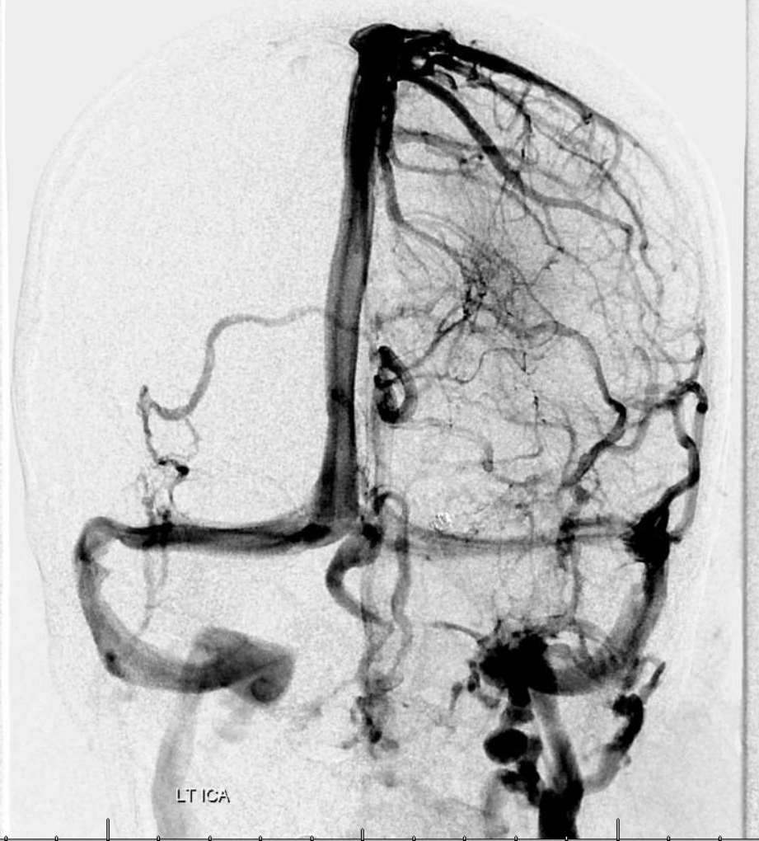
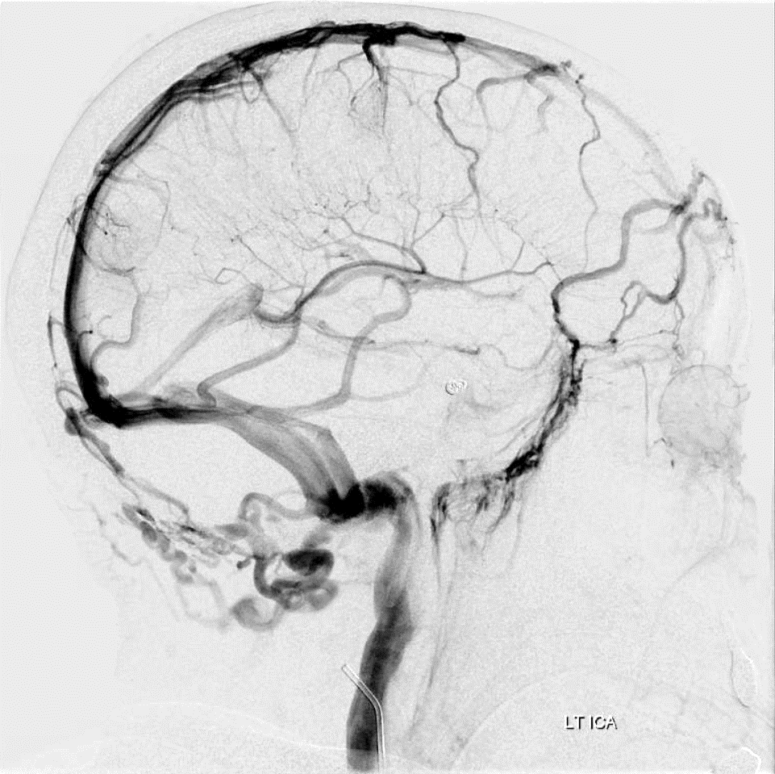

Slide 3
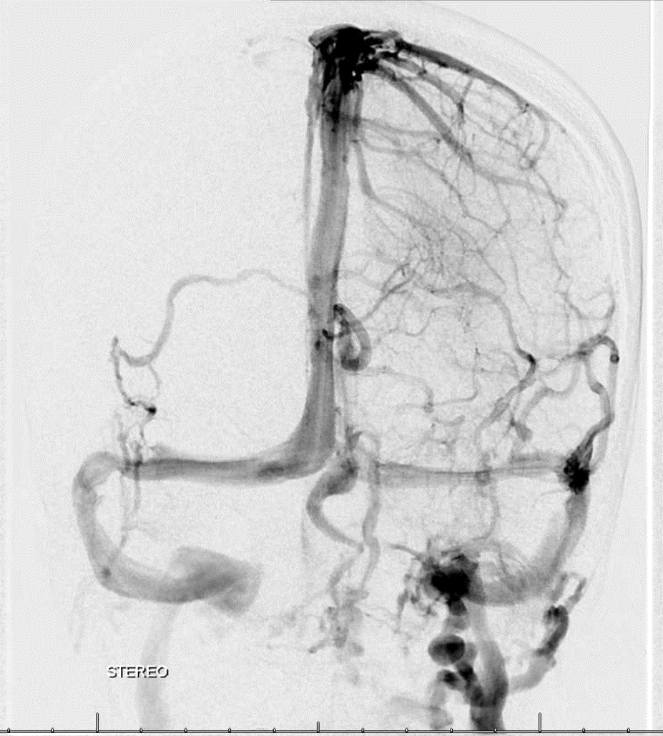
cross eye stereo pair
cross eye stereo pair

Slide 4
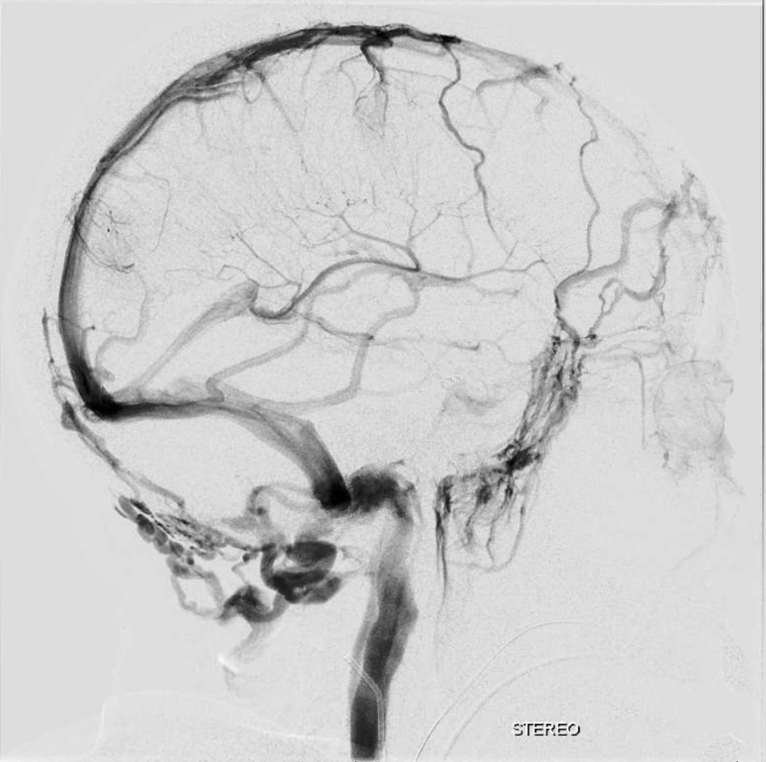
cross eye stereo pair
cross eye stereo pair

