Slide 1
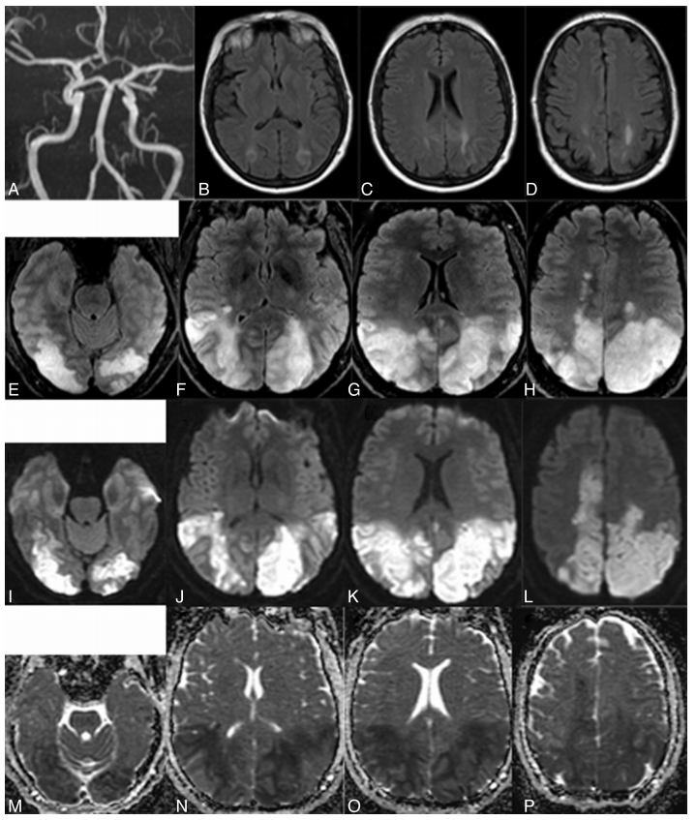
Farid H1, Tatum JK, Wong C, Halbach VV, Hetts SW. Reversible cerebral vasoconstriction syndrome: treatment with combined intra-arterial verapamil infusion and intracranial angioplasty.AJNR Am J Neuroradiol. 2011 Nov-Dec;32(10):E184-7.

Slide 2
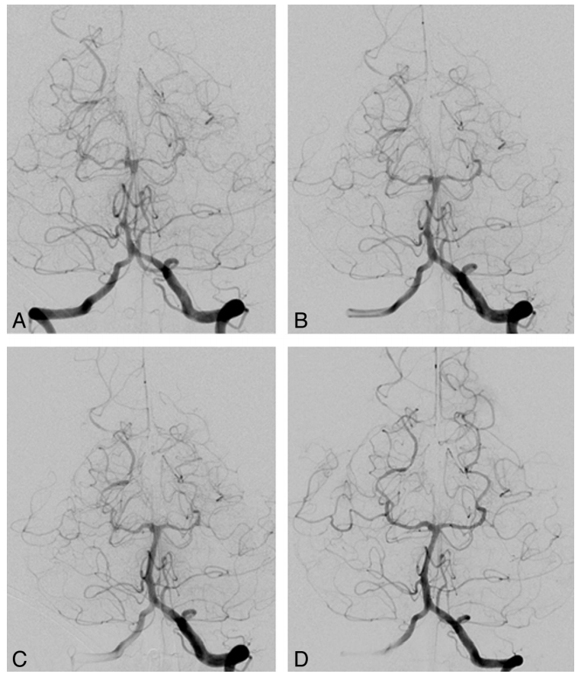

Slide 3
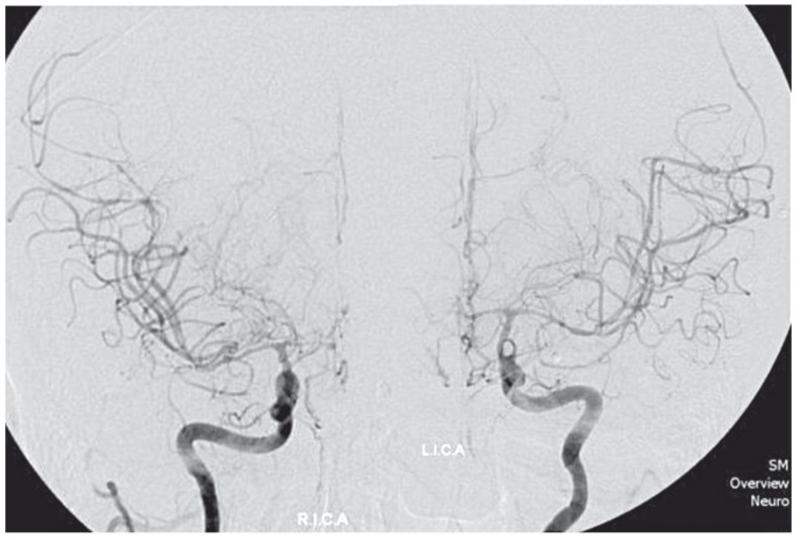
I. Ioannidis,1 N. Nasis,1 E. Agianniotaki,2 E. Katsouda,3 and A. Andreou Interv Neuroradiol. 2012 Sep; 18(3): 297–302. Reversible Cerebral Vasoconstriction Syndrome: Treatment with Multiple Sessions of Intra-Arterial Nimodipine and Angioplasty

Slide 4
