Slide 1
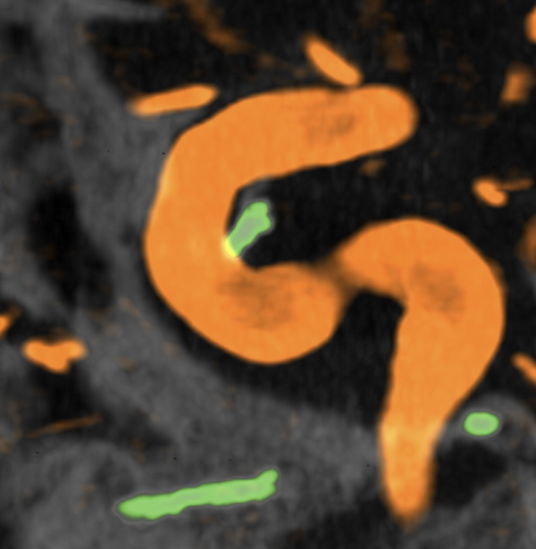
A Leak Without a Trail
BANANA 🍌 Team
Department of Neurosurgery and Radiology, NYU Langone Health, New York

Slide 2
Relevant Disclosure
Consultant for JJ and proctor for nBCA
Consultant for Terumo Neurovascular
Consultant for Siemens

Slide 3
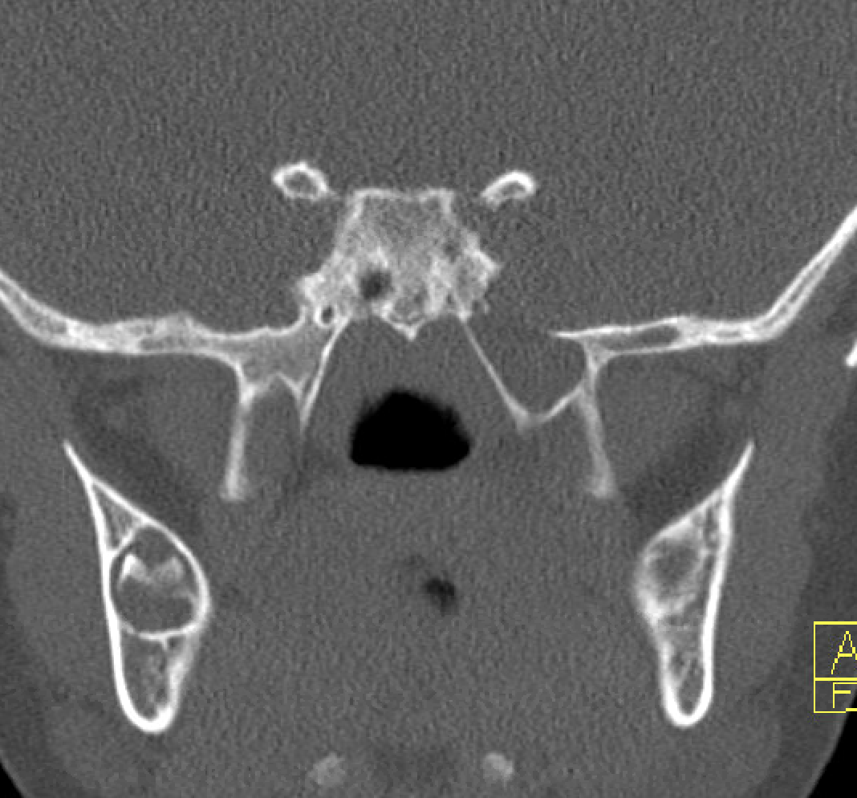
Patient History
Now 12 yo boy
9 years history of skull base defect and CSF leak with recurrent meningitis and positional headache since yo
History of treated meningoceles
Despite that, continues to have recurrent meningitis and positional headache
3 myelogram/cisternograms done
Now in 2025 they ask for a repeat cisternogram

Slide 4
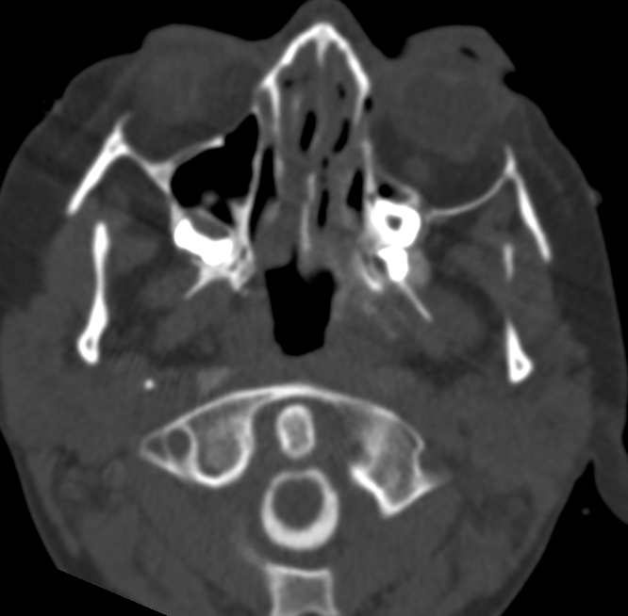
Cisternogram 2025
Credit Andrew McClelland Neuroradiology

Slide 5
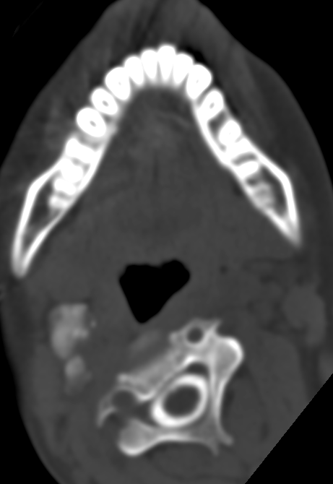
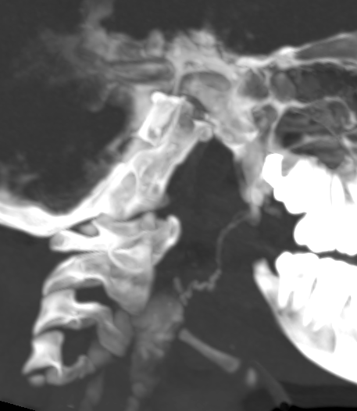
Cisternogram 2025
CSF Lymphatic Fistula

Slide 6
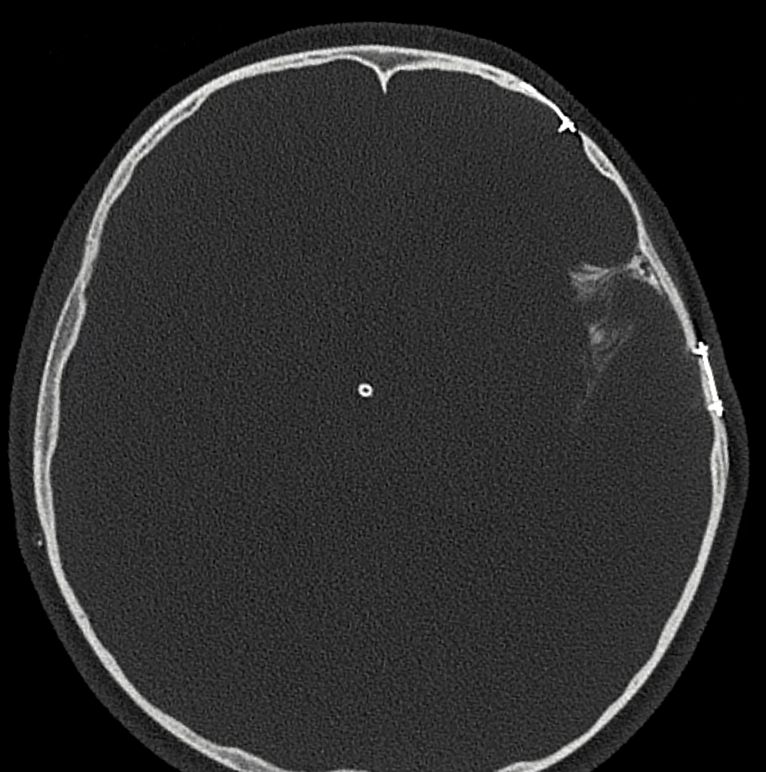
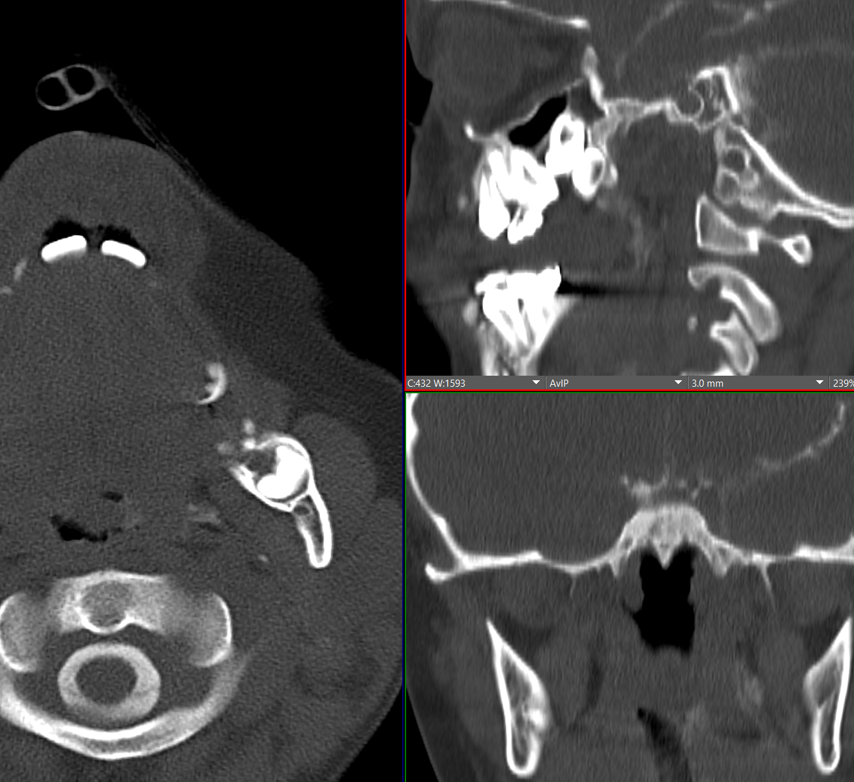
Cisternogram years before

Slide 7
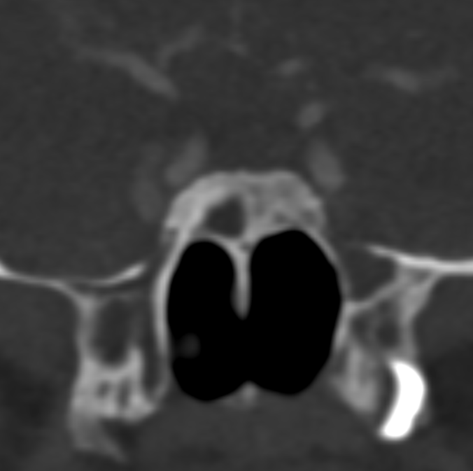
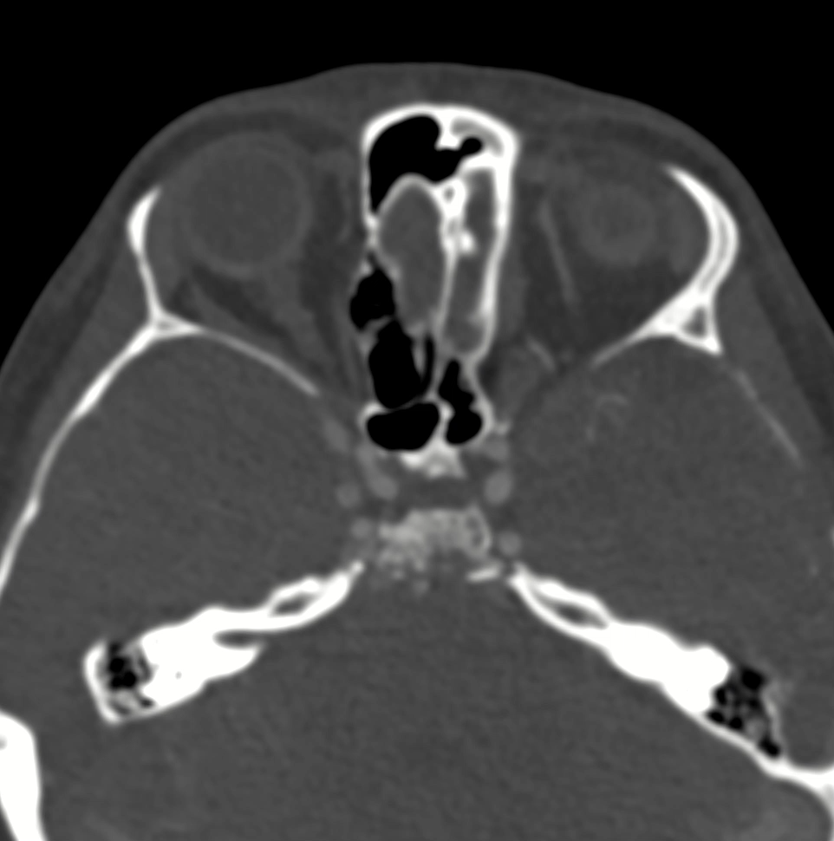
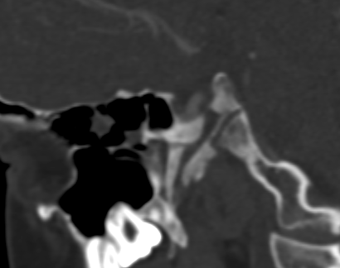
Bone Channels!
Gorham Stout Disease?

Slide 8
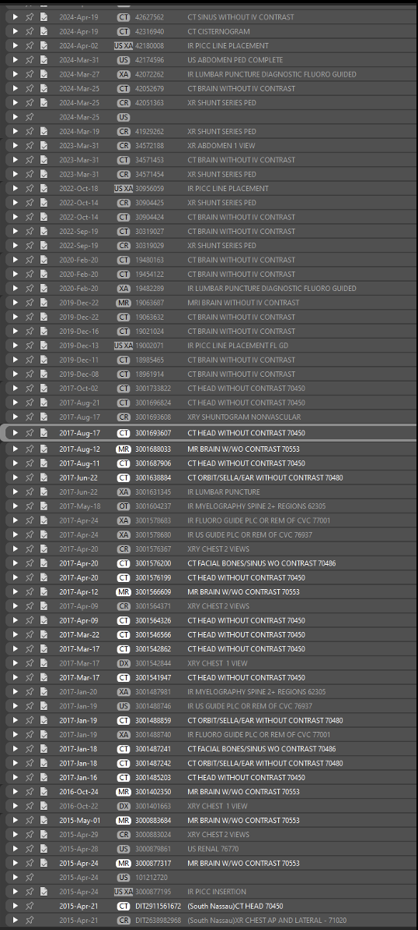
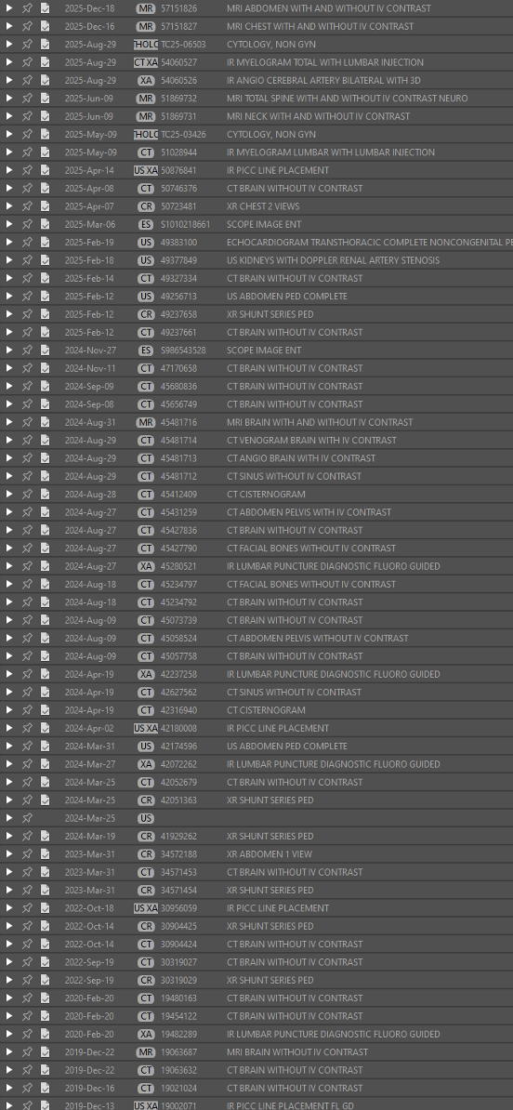
DIAGNOSIS MADE

Slide 9
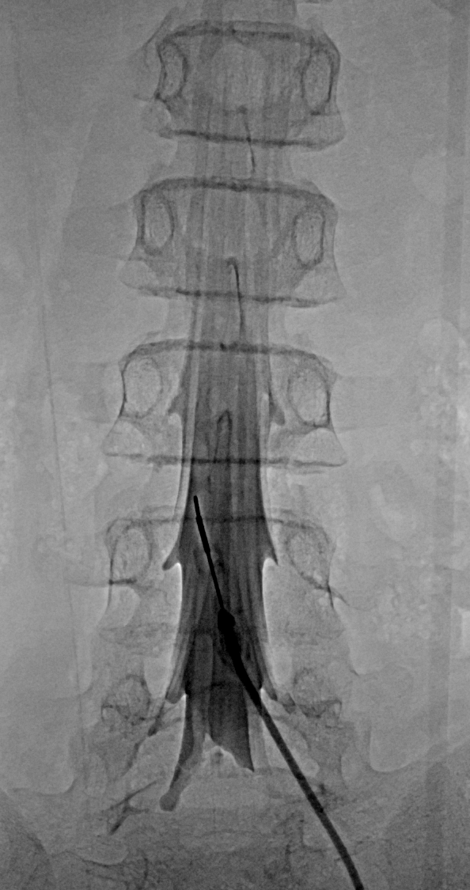
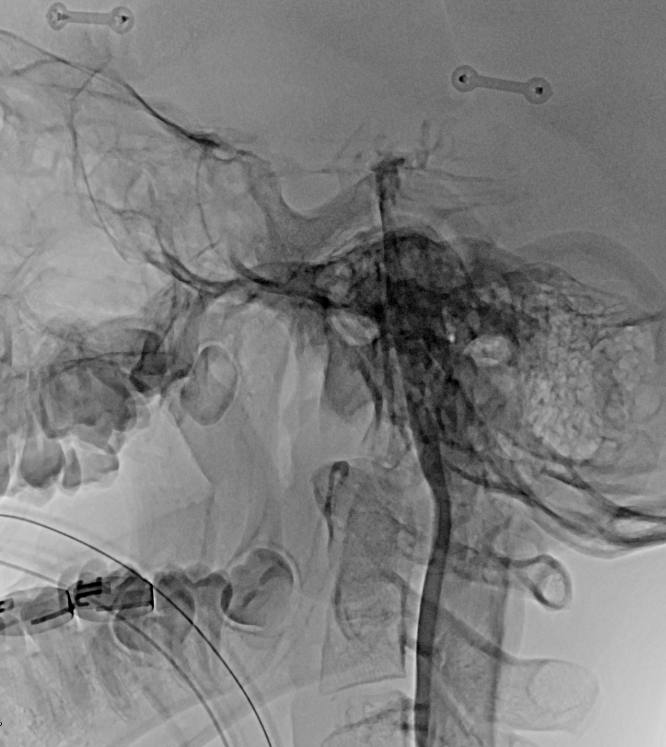
We decided to investigate this further:
Cisternogram with patient prone

Slide 10
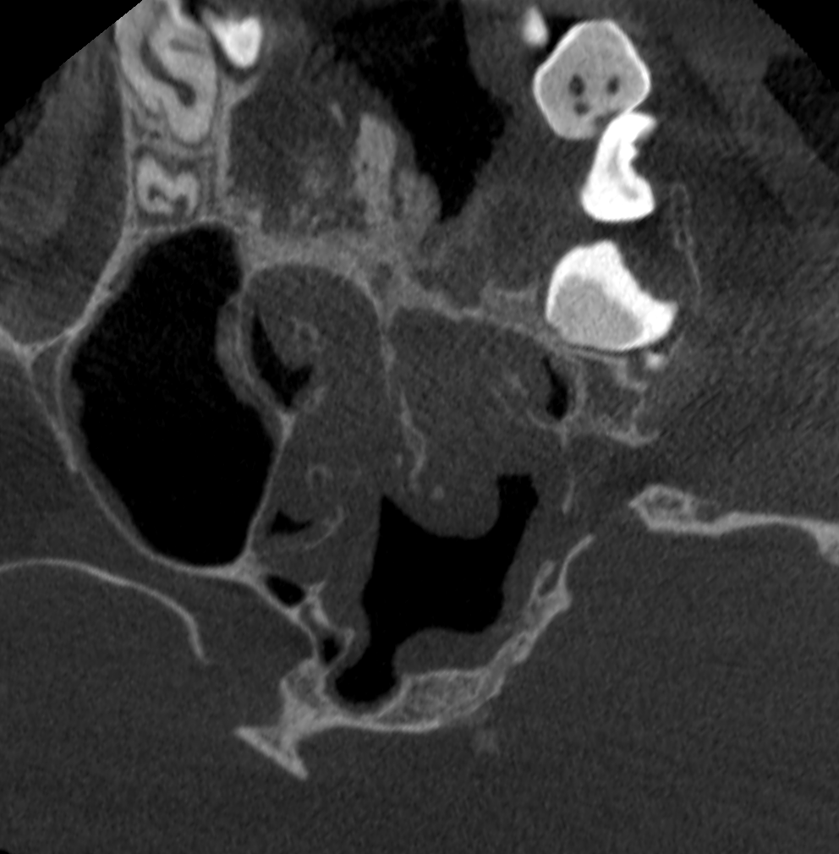
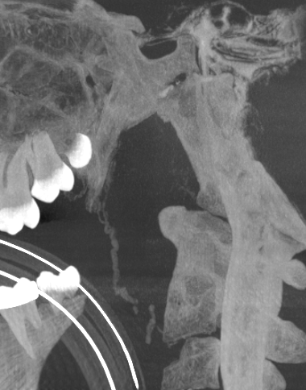
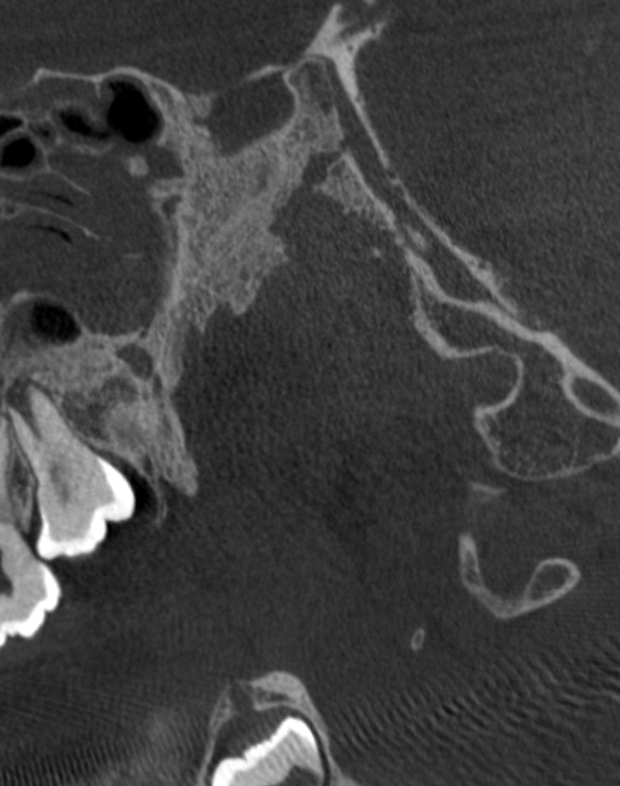
Confirmed leak with CBCT

Slide 11
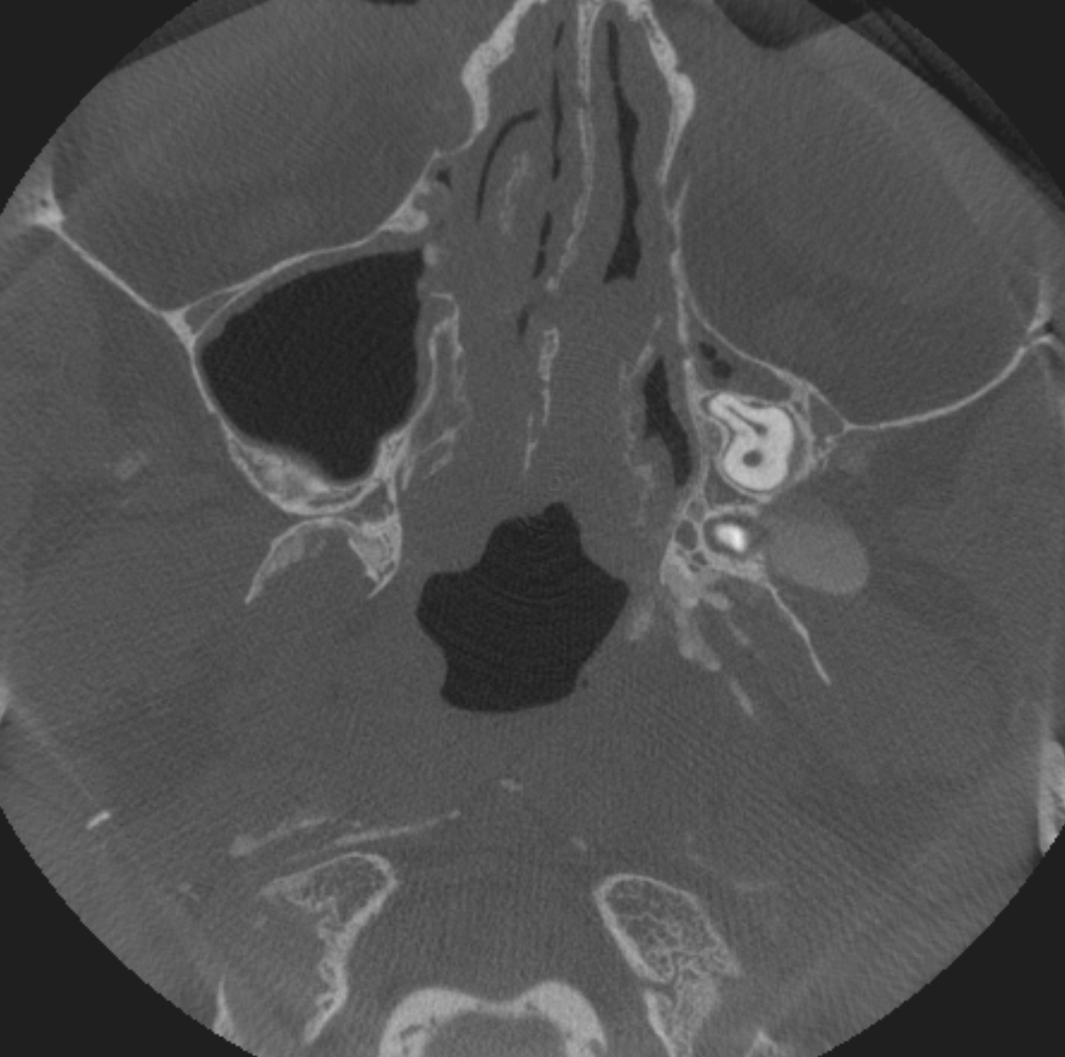
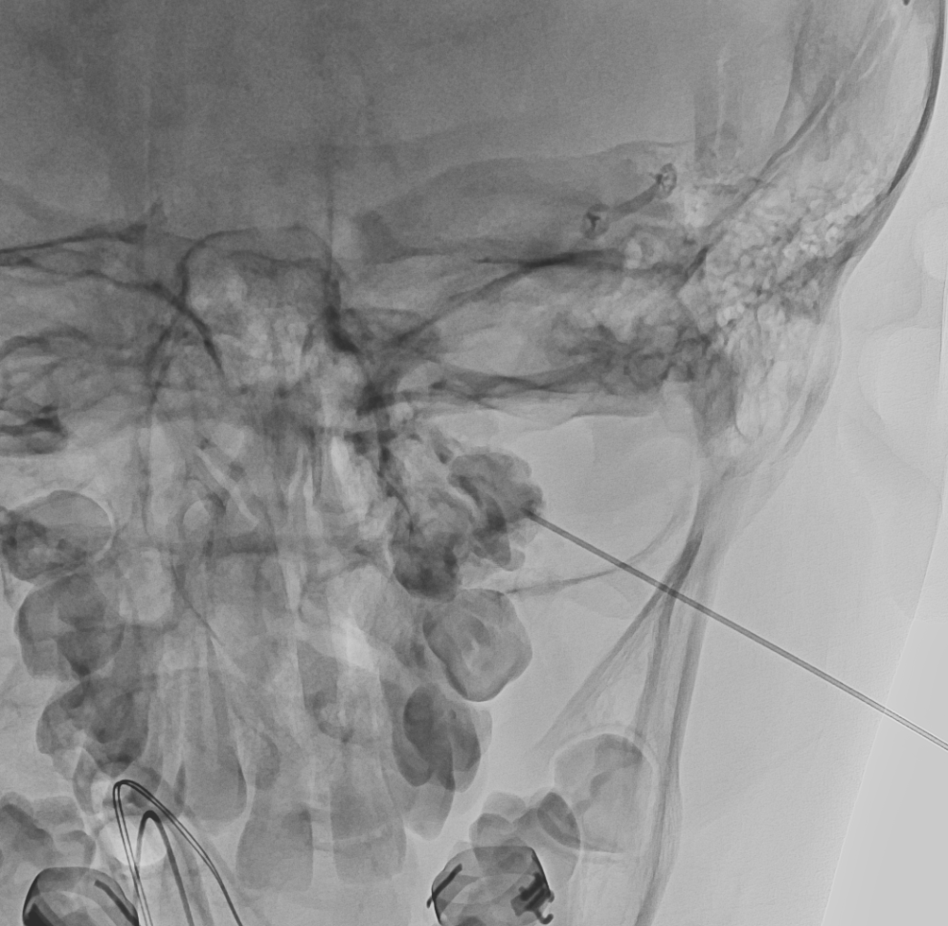
Patient turned supine and big pouch accessed directly

Slide 12
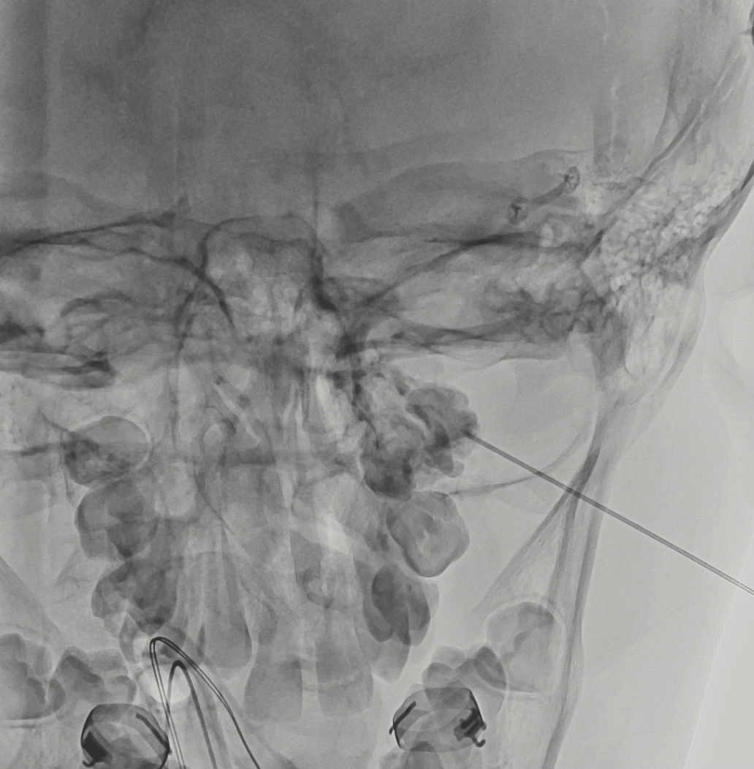
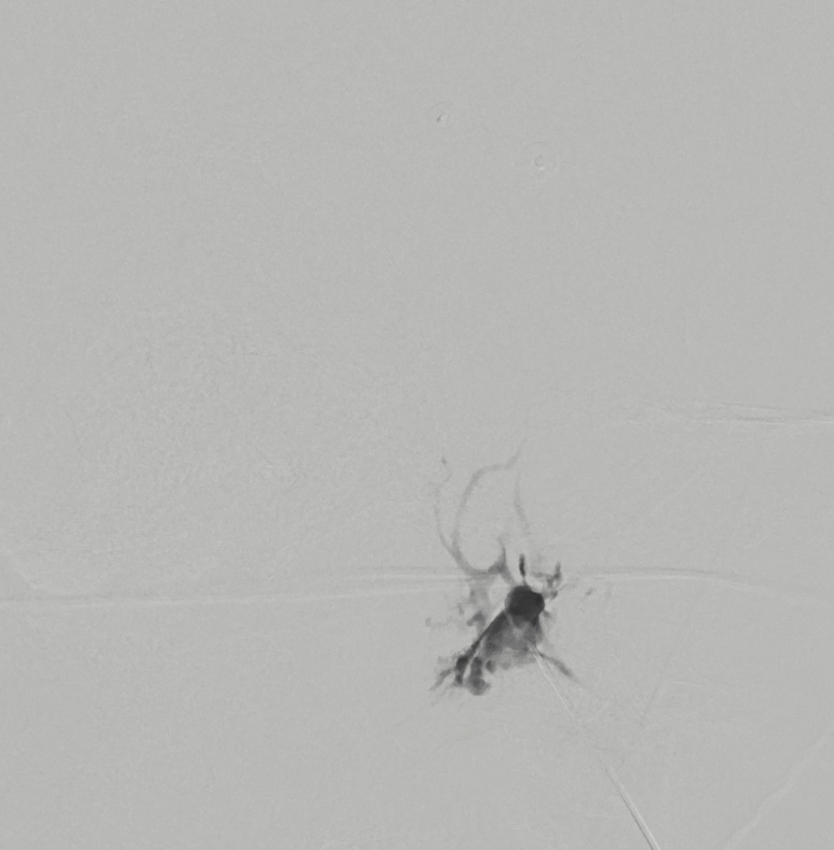
Retrograde Lymphography

Slide 13
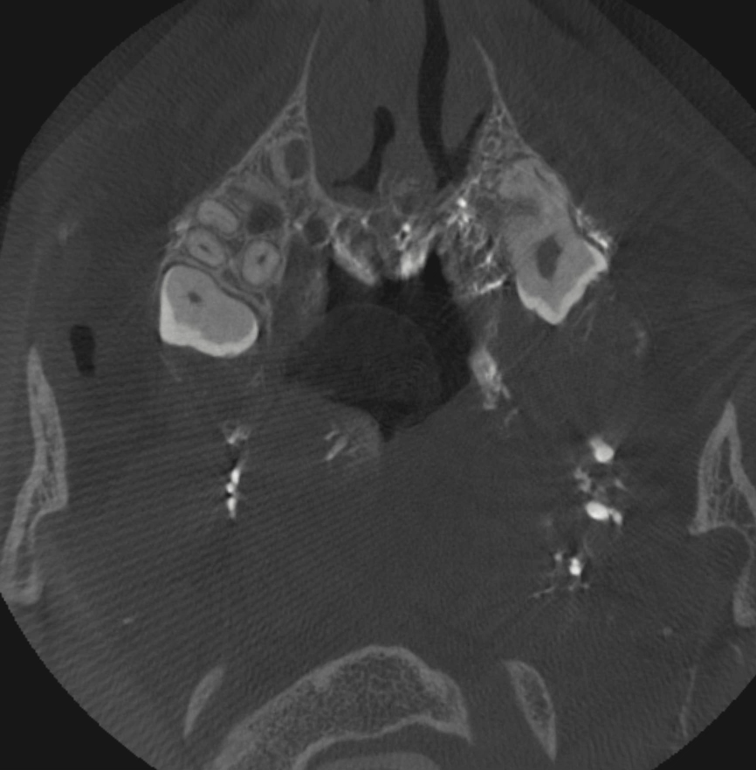
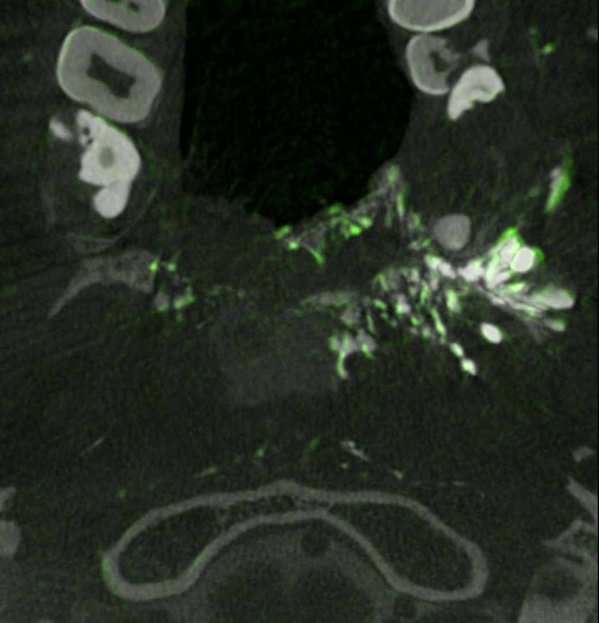

Slide 14
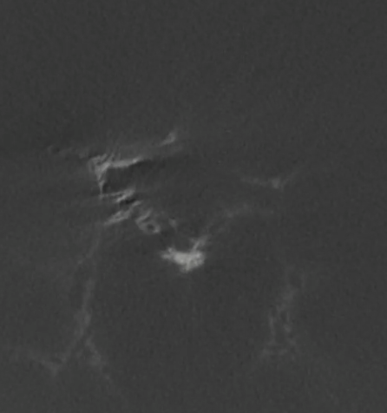
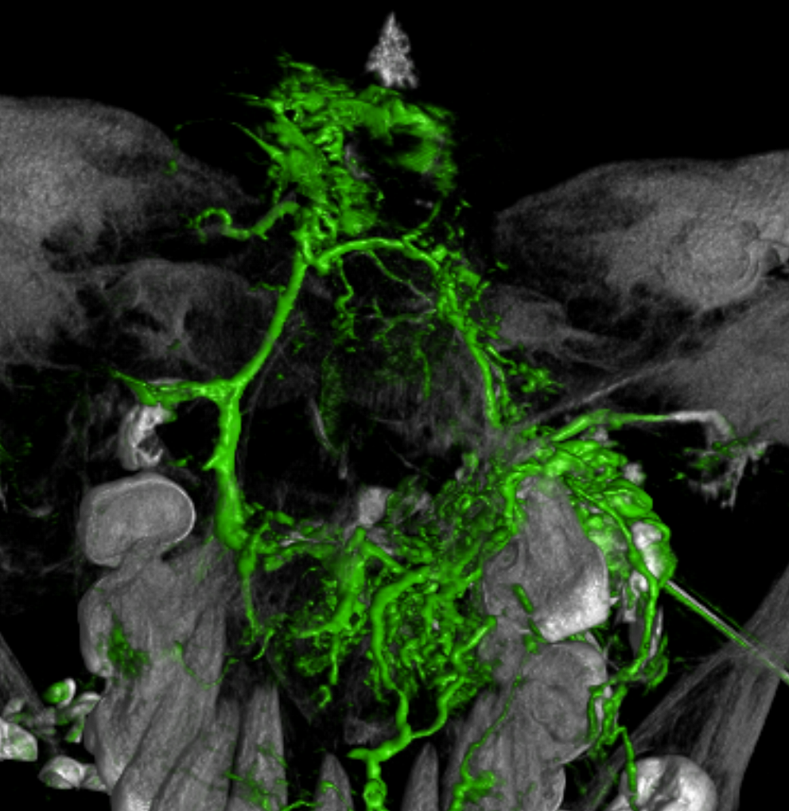

Slide 15
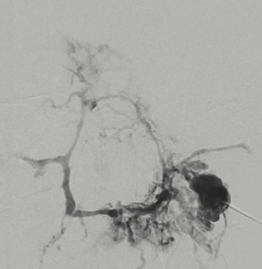
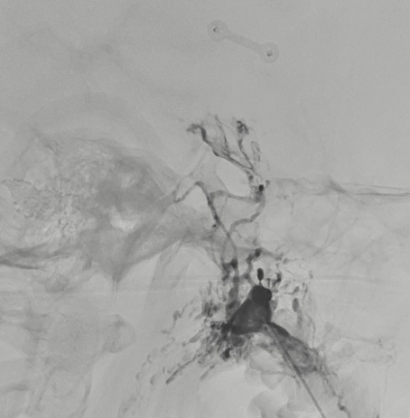
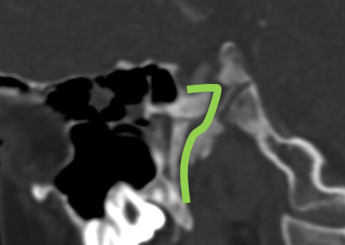

Slide 16
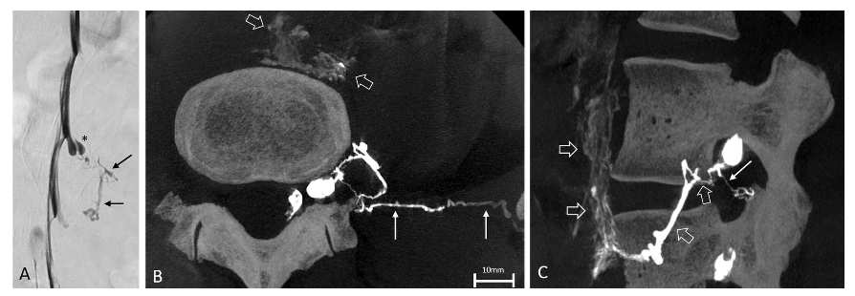
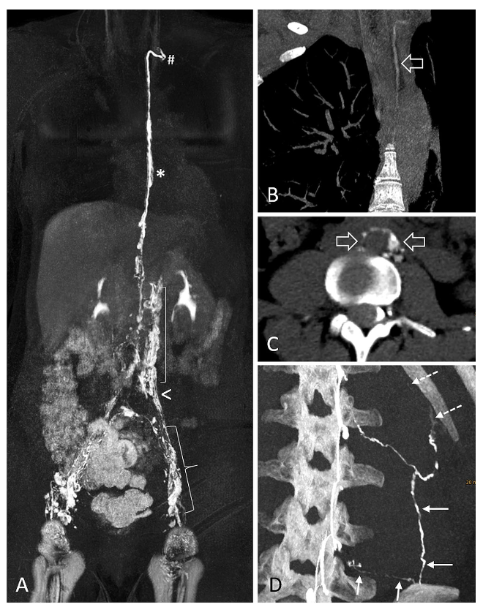
Literature – CSF Lymphatic Fistula
CSF-lymphatic fistulas only in a few cases mostly in association with:
Venolymphatic malformation
Gorham–Stout disease
Klippel–Trenaunay
Kaposiform lymphangiomatosis
One recent idiopathic case

Slide 17
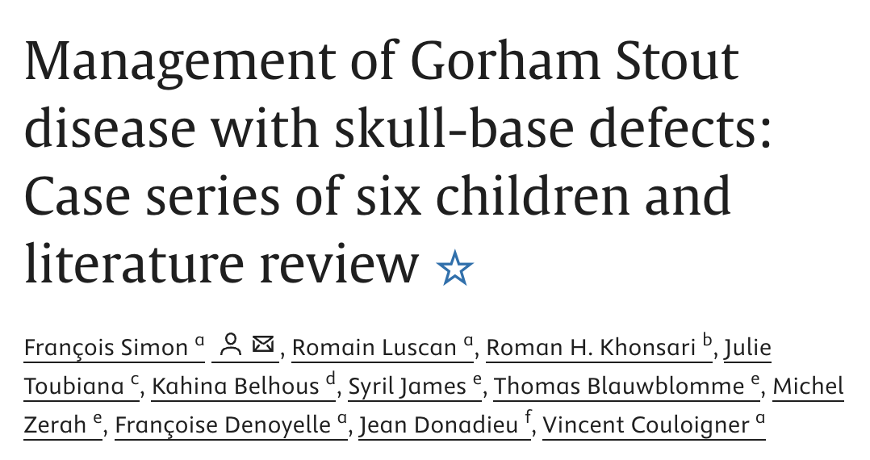
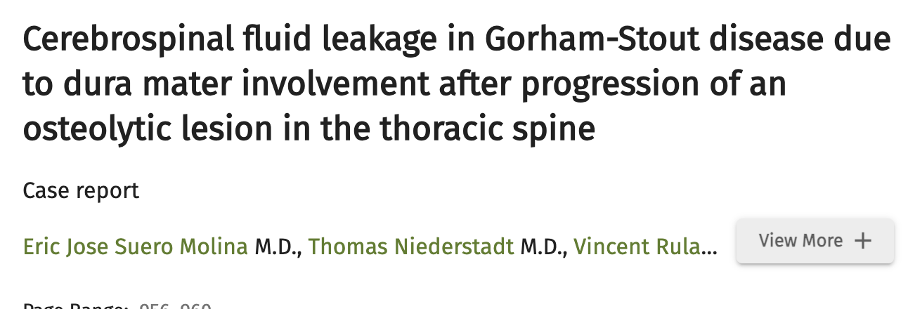
Literature - Gorham Stout Disease
Gorham Stout Disease
gradual bone loss (osteolysis) caused by an abnormal overgrowth of lymphatic vessels

Slide 18
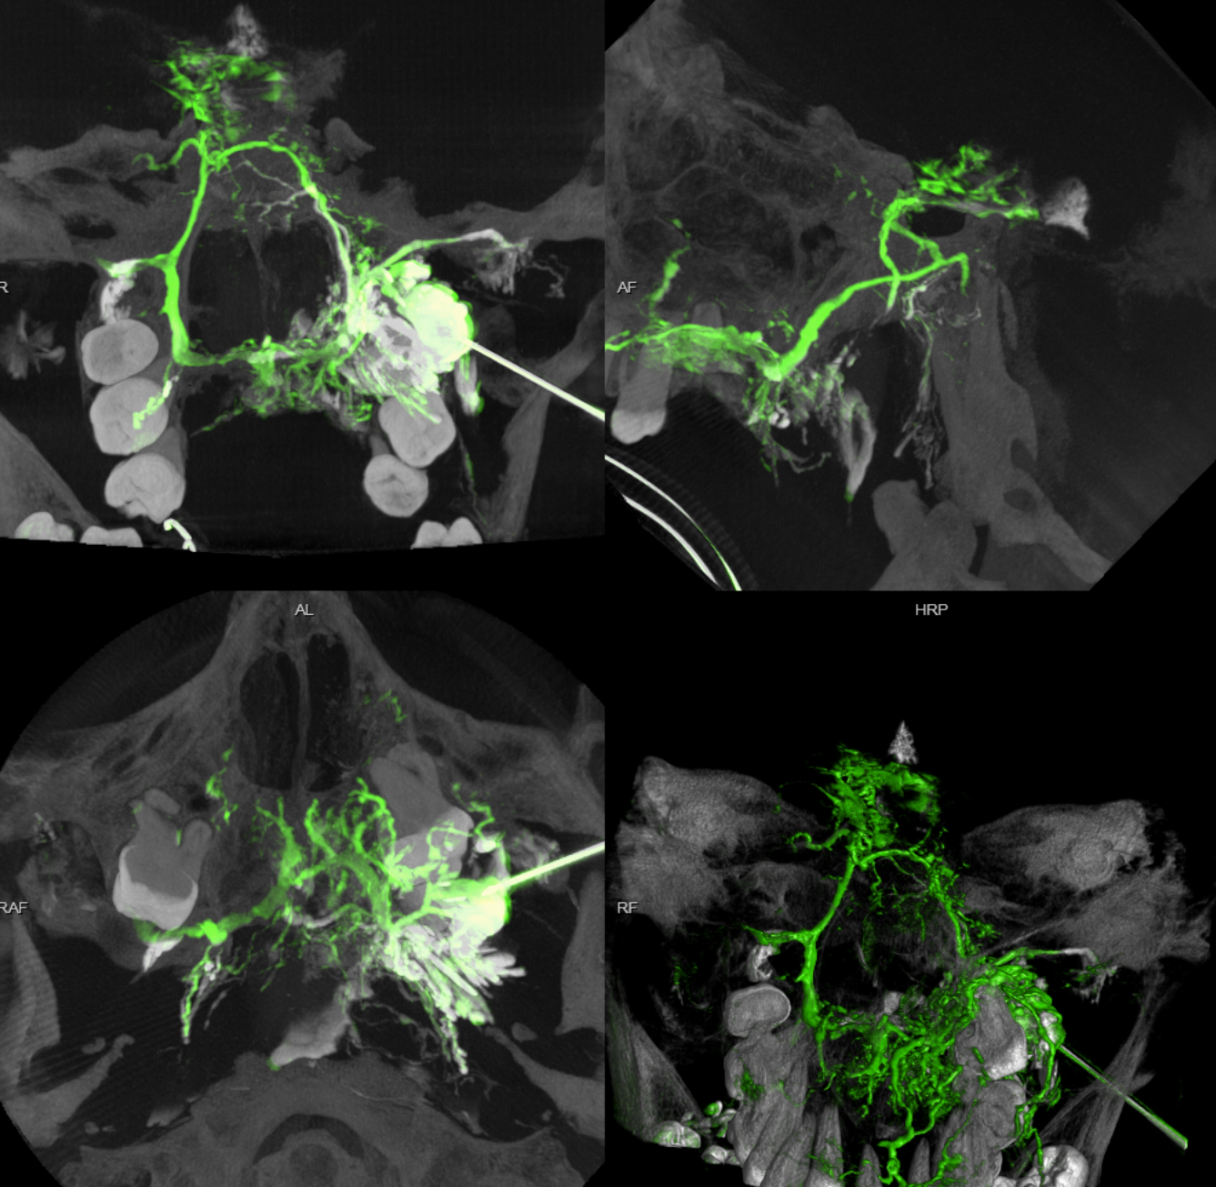
What to do?

Slide 19
Closest and straightest pathway?

Slide 20
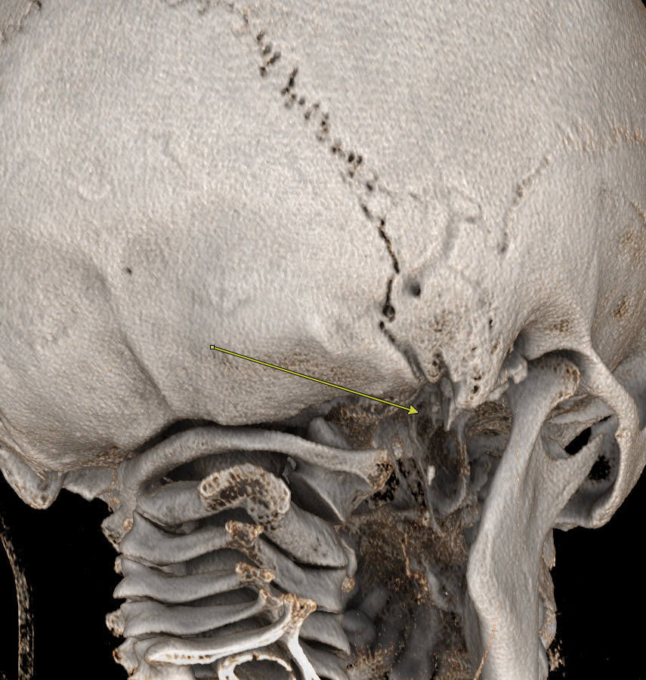
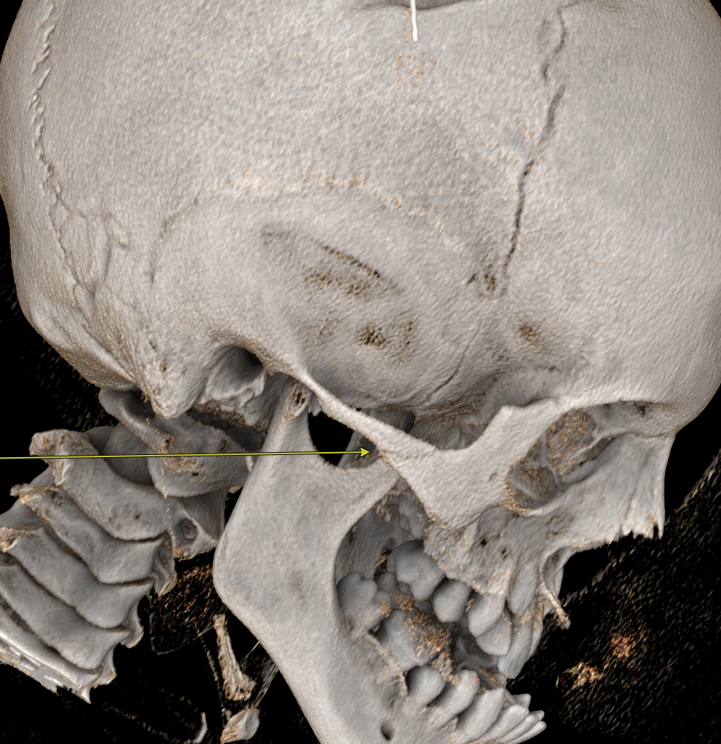
Planned direct stick approach

Slide 21
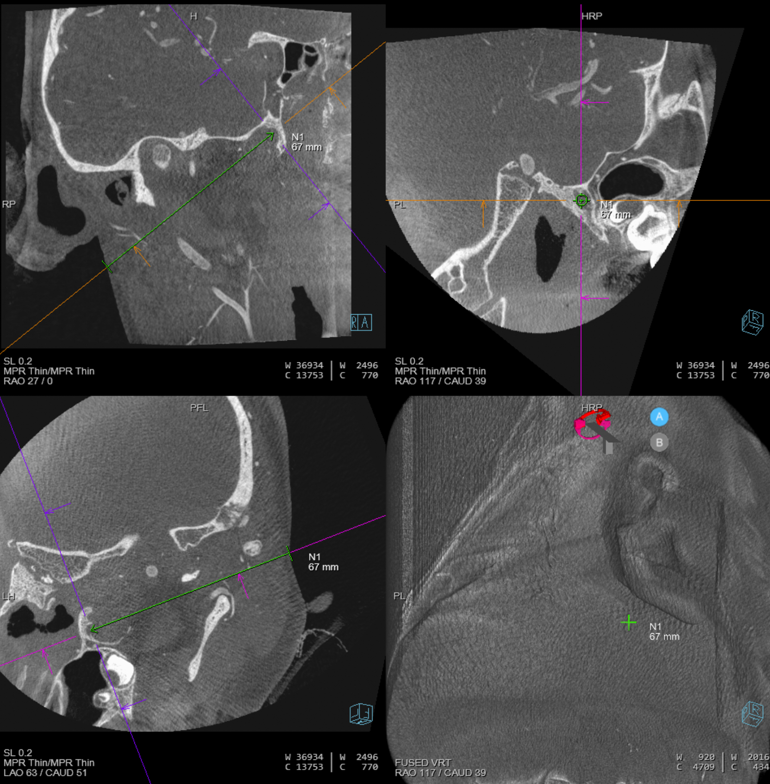
Angio patient prone, 3D-DSA of right CCA and Needle Guidance trajectory

Slide 22
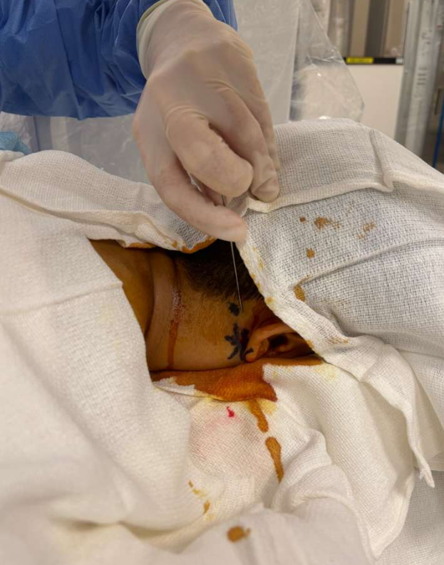
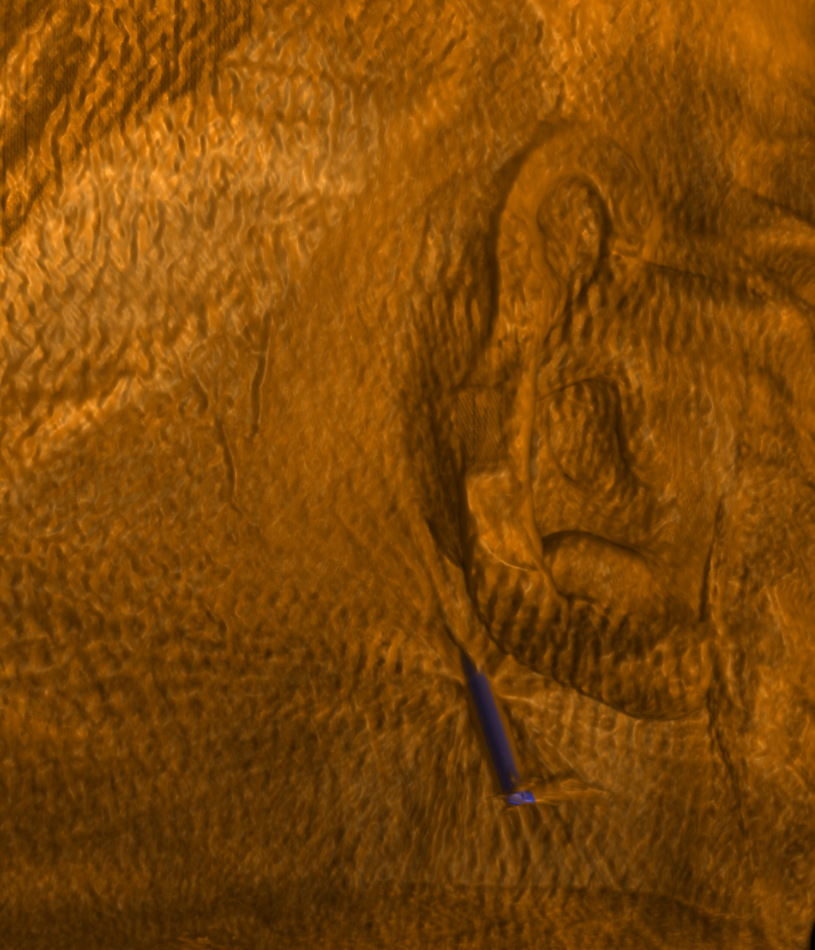

Slide 23
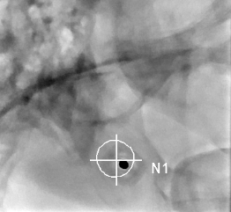
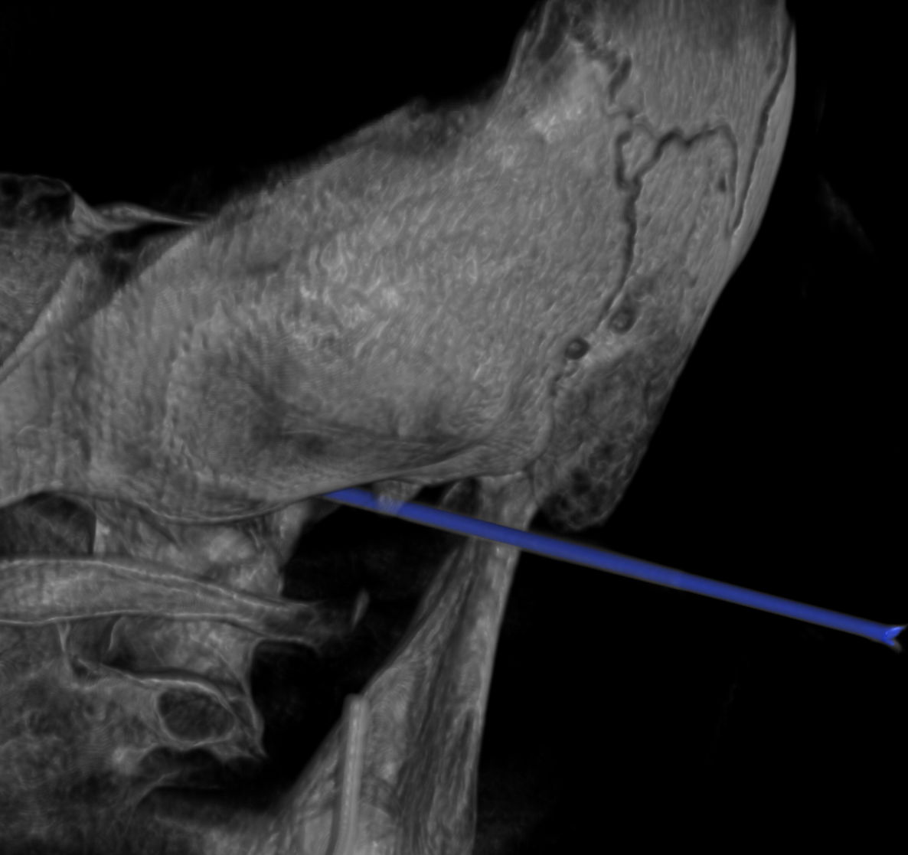
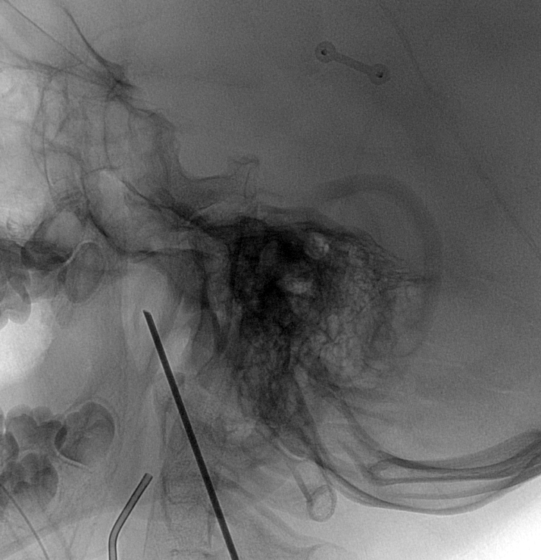
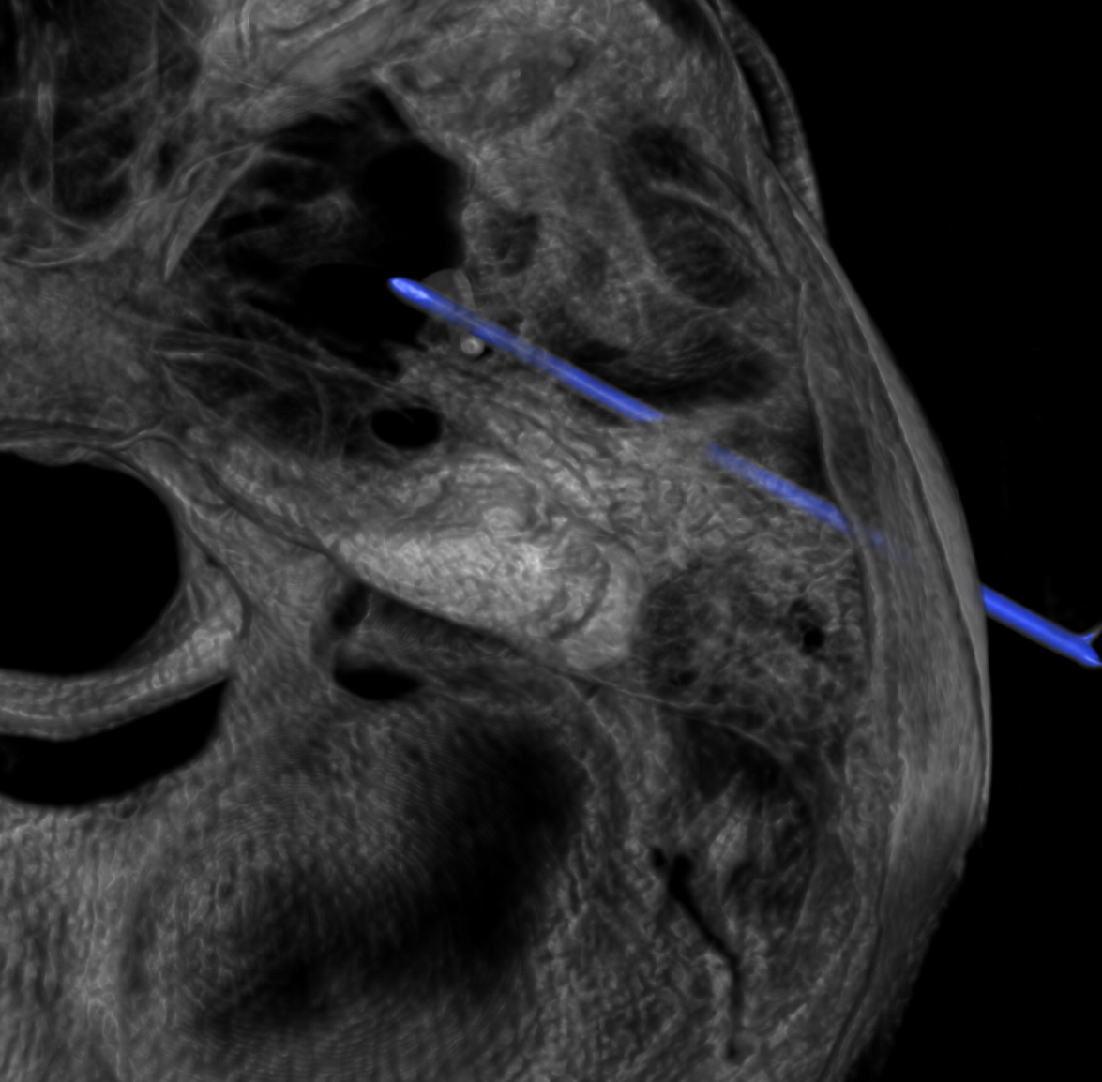

Slide 24
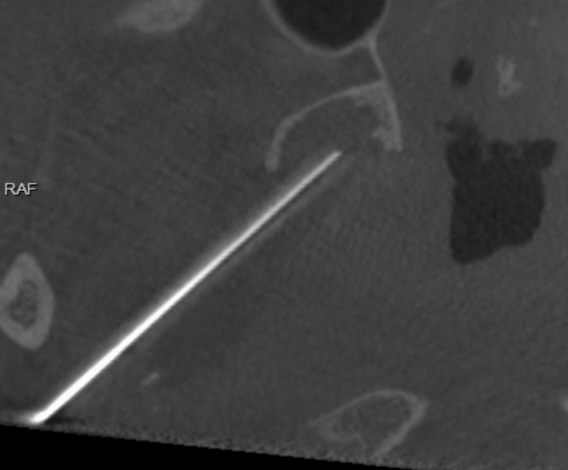
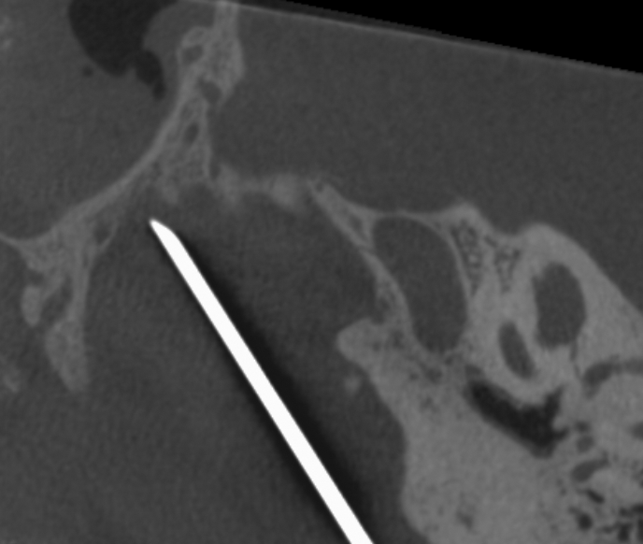

Slide 25
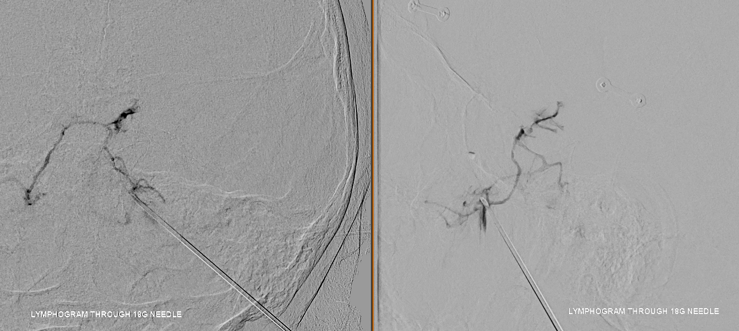
Tried gently to catheterize but not straightforward, decided to glue from this position

Slide 26
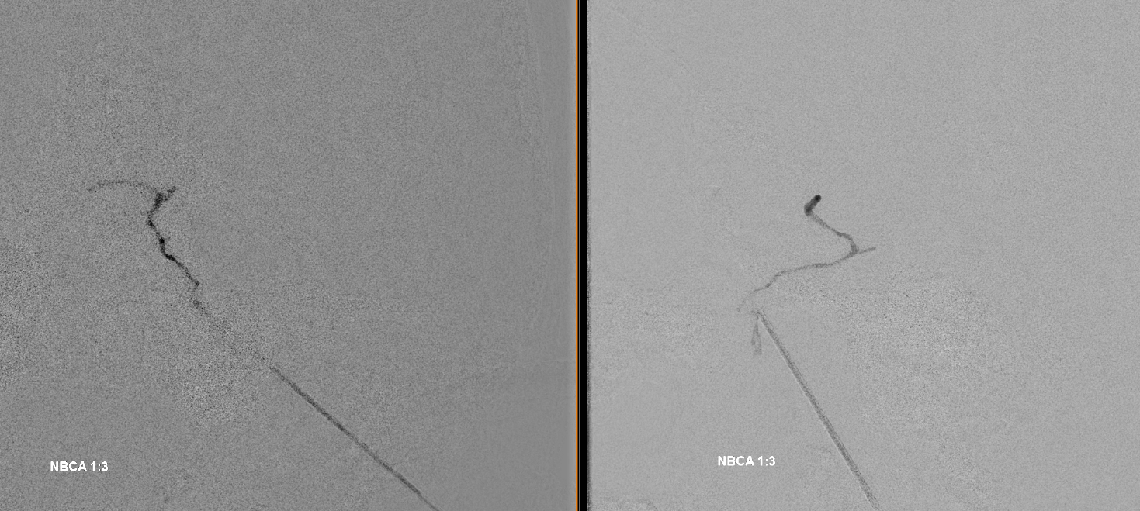
nBCA 1:3 injected through HW Duo positioned within needle at its tip

Slide 27
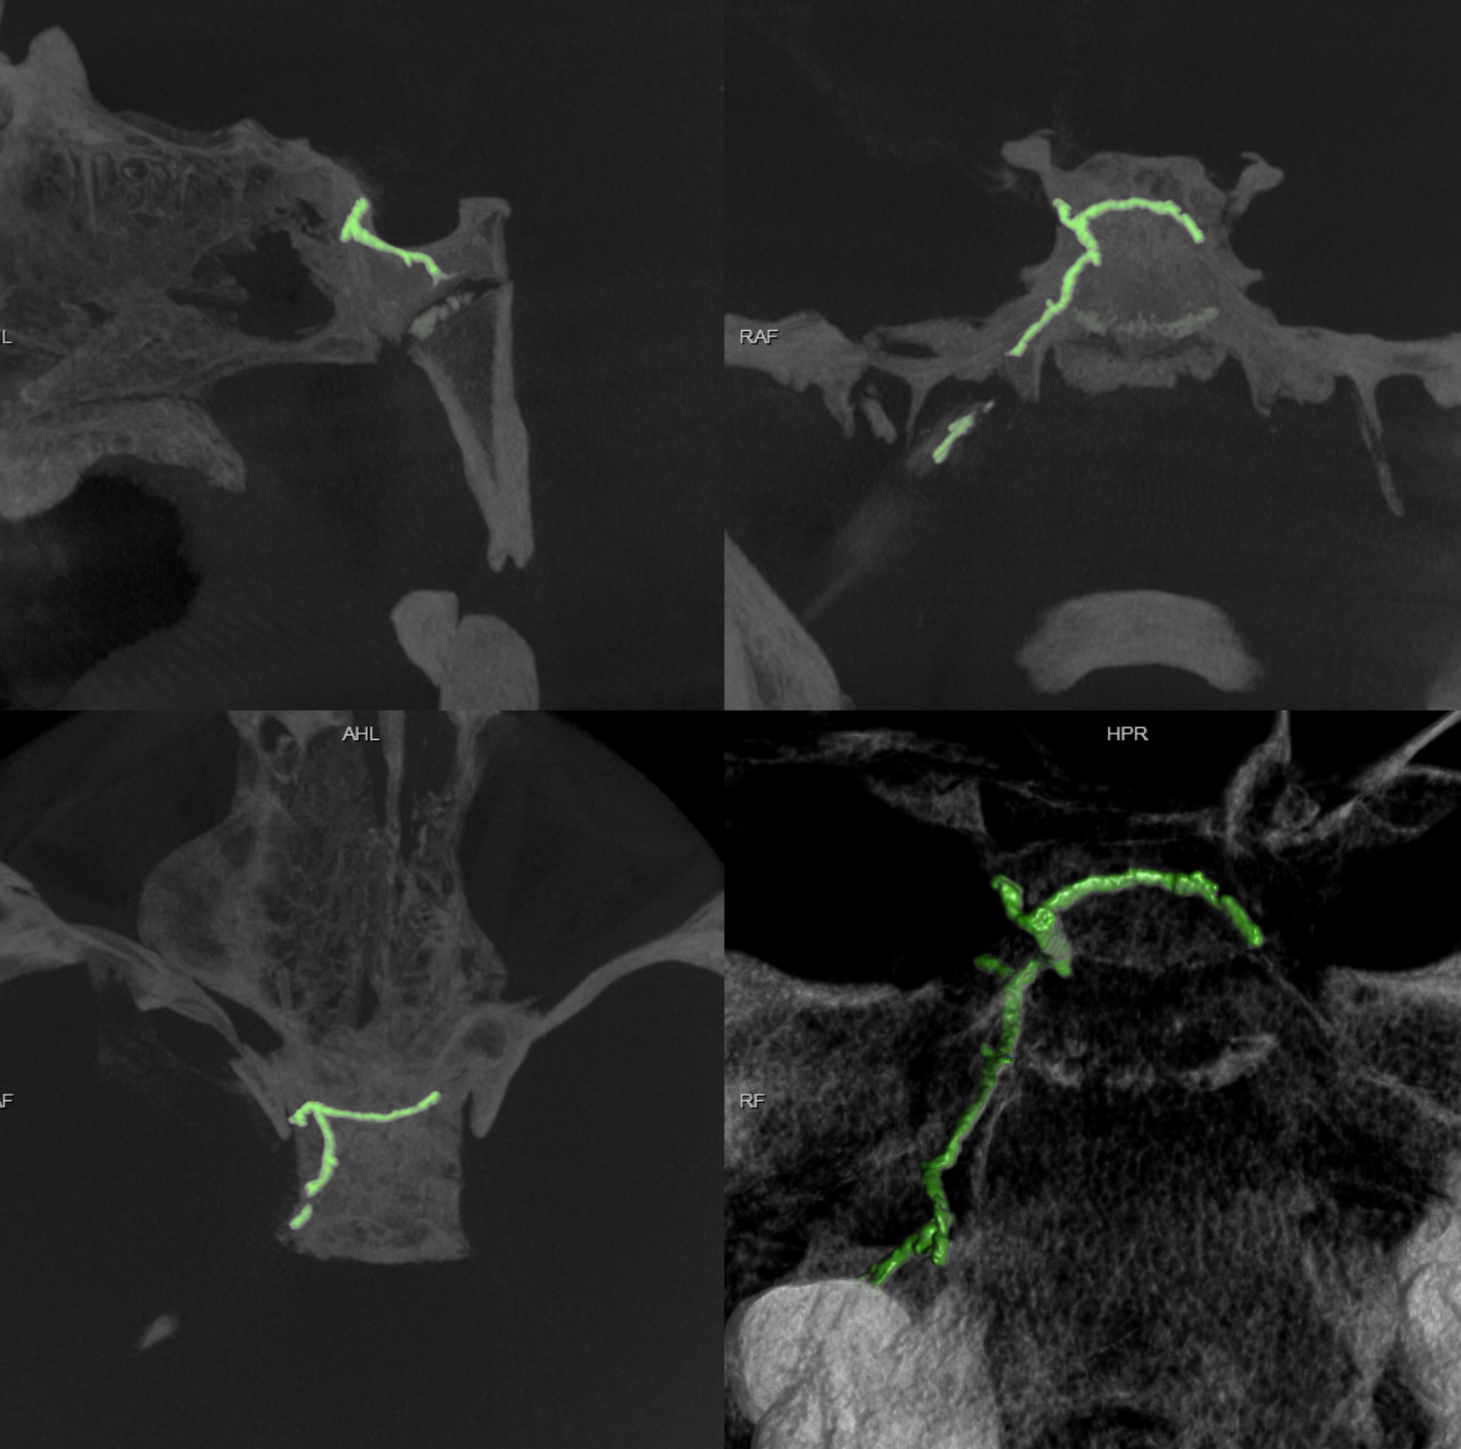
Post treatment , n-BCA in green

Slide 28
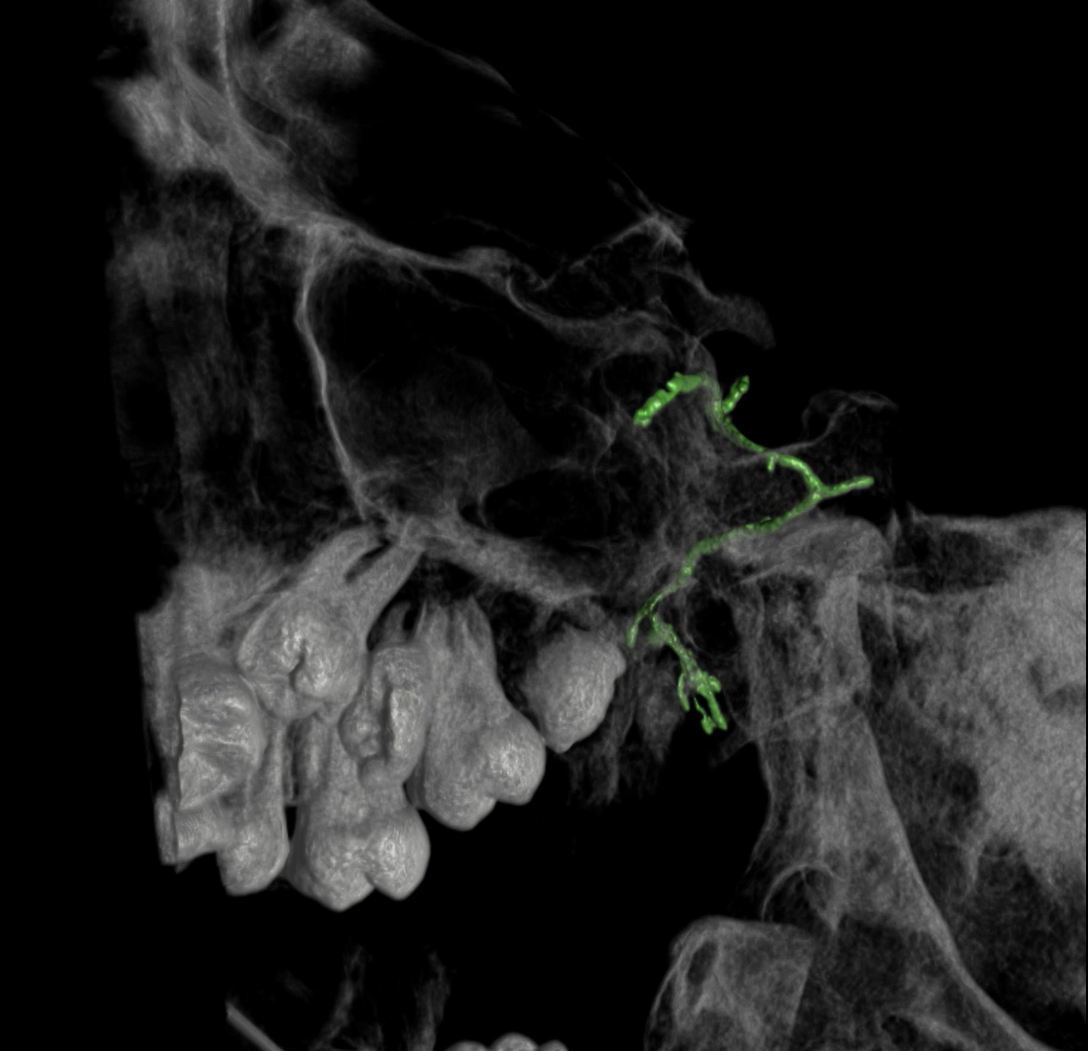
Post treatment , n-BCA in green

Slide 29
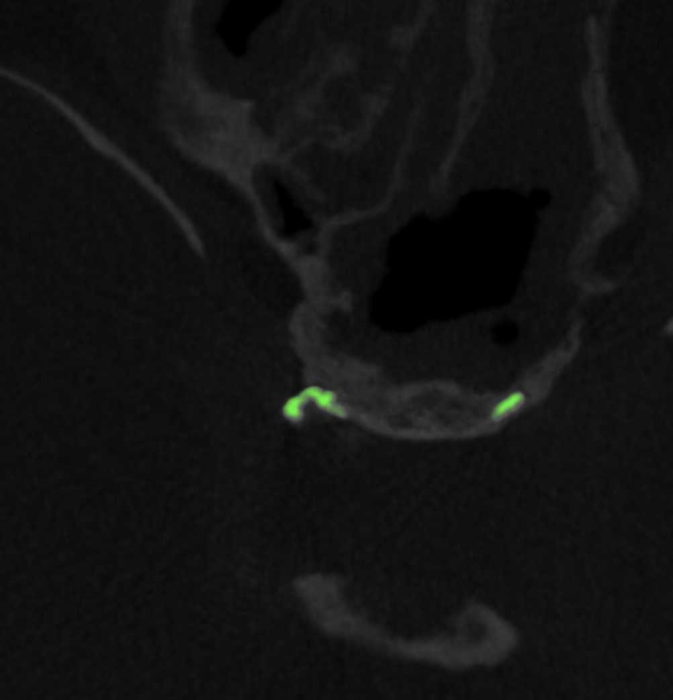
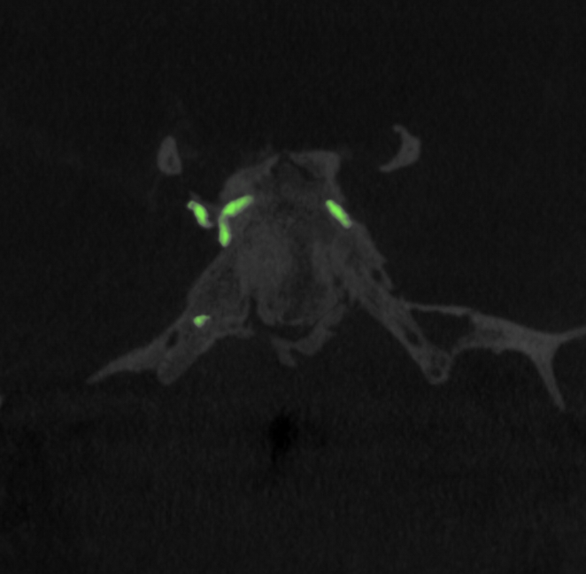
Point of Fistula!

Slide 30


Relationship of Fistula to ICA

Slide 31


Slide 32

Outcome:
Placed on antibiotics for few days
No immediate complications

Slide 33


Summary
CSF-LF, a one-off or an underdiagnosed entity?
Consequence of another disease? (Gorham Stout?)
Treat or leave alone? Safety of treatment?
😜

