Slide 1
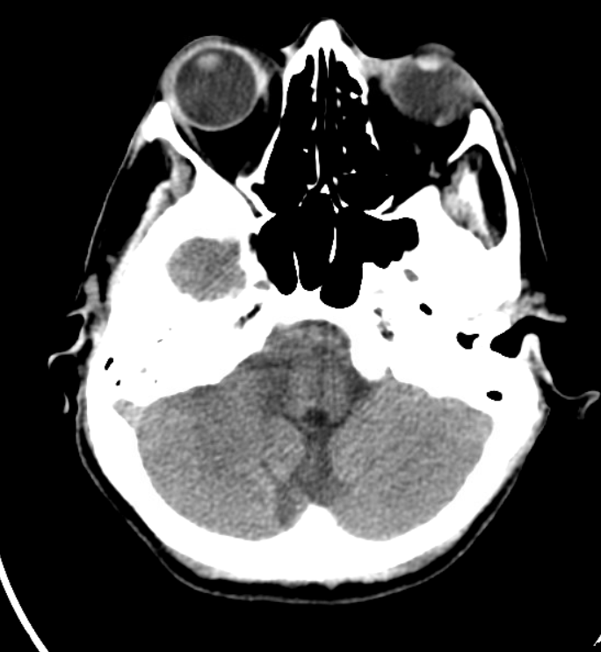
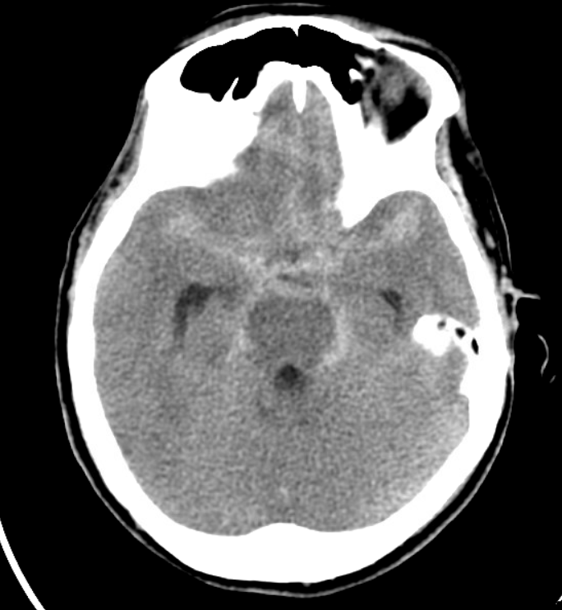
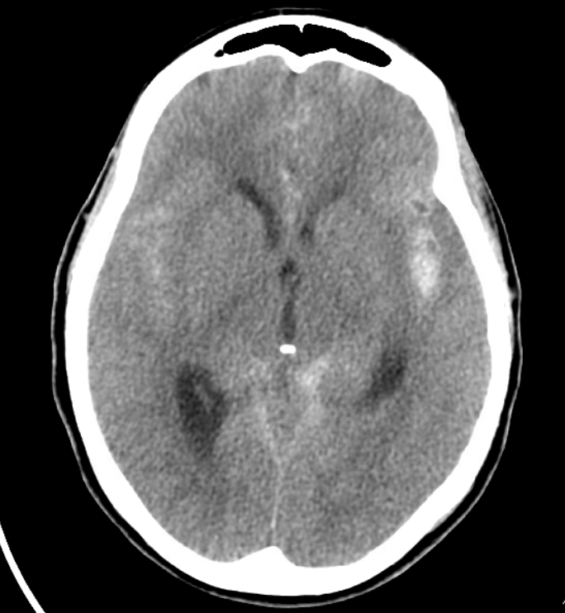
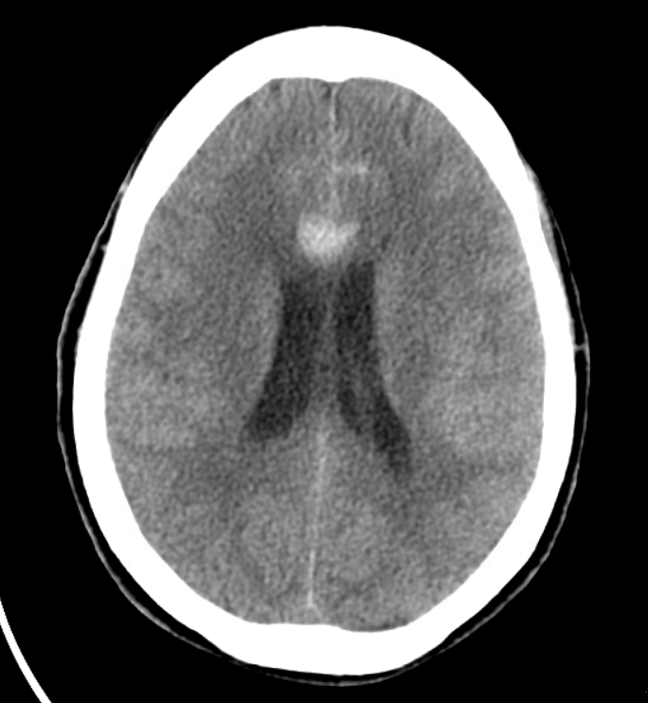
3678539

Slide 2
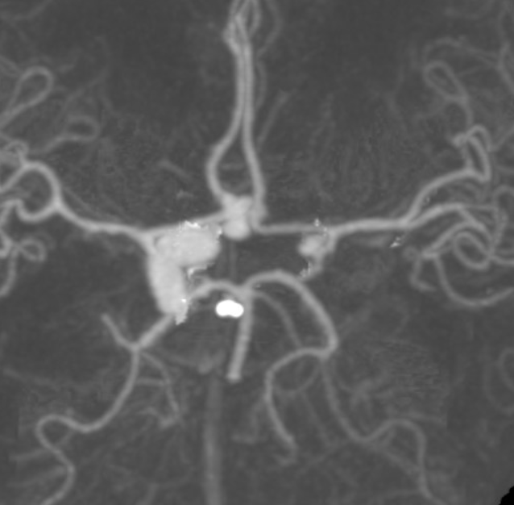
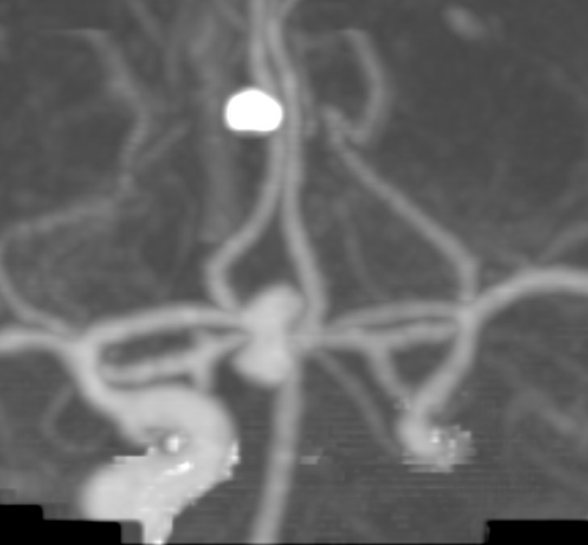
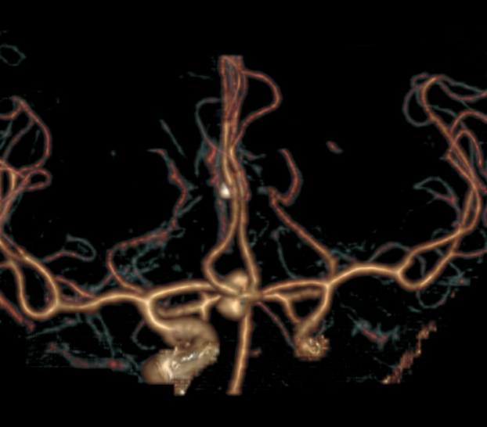
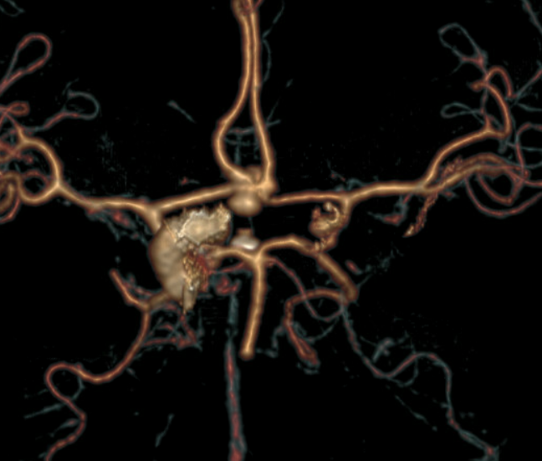

Slide 3
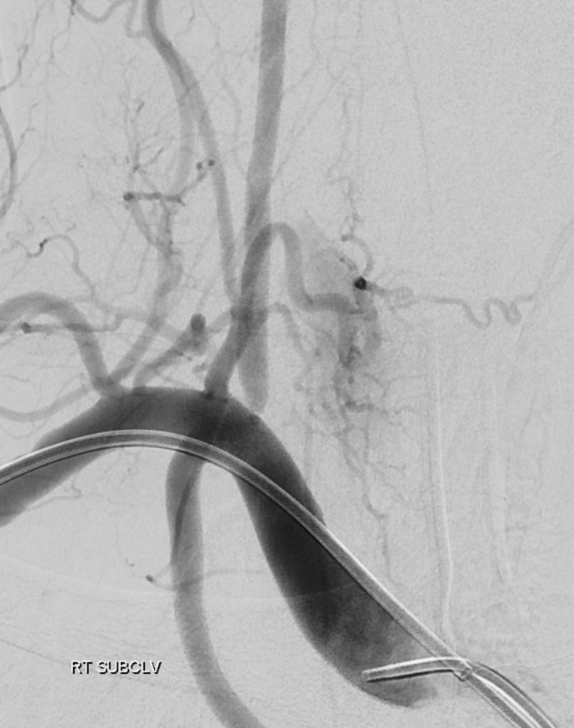
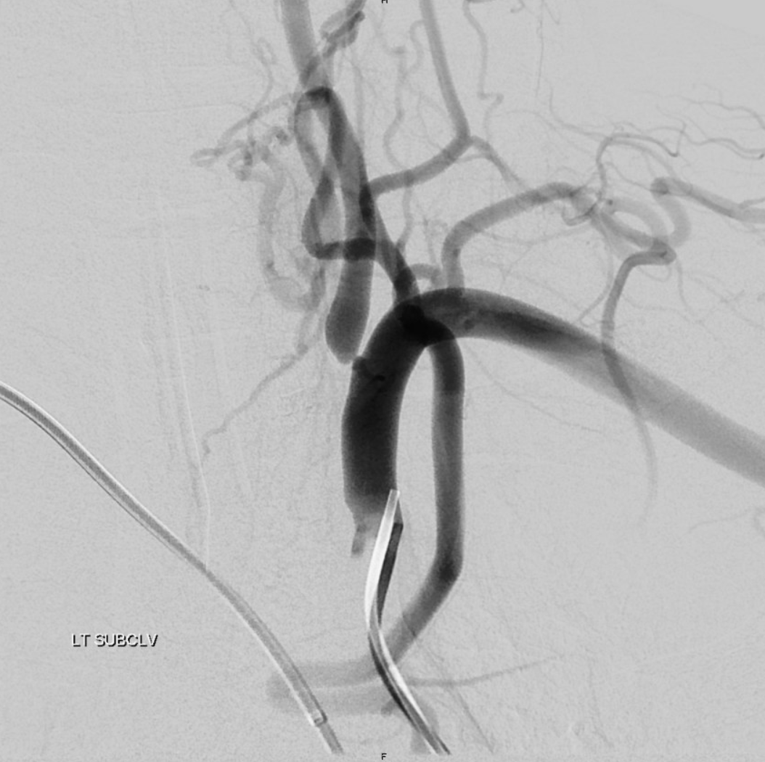
3678539

Slide 4
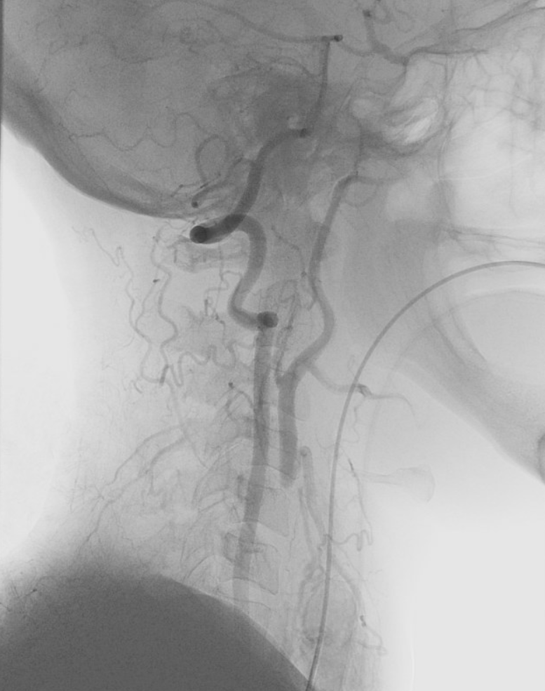
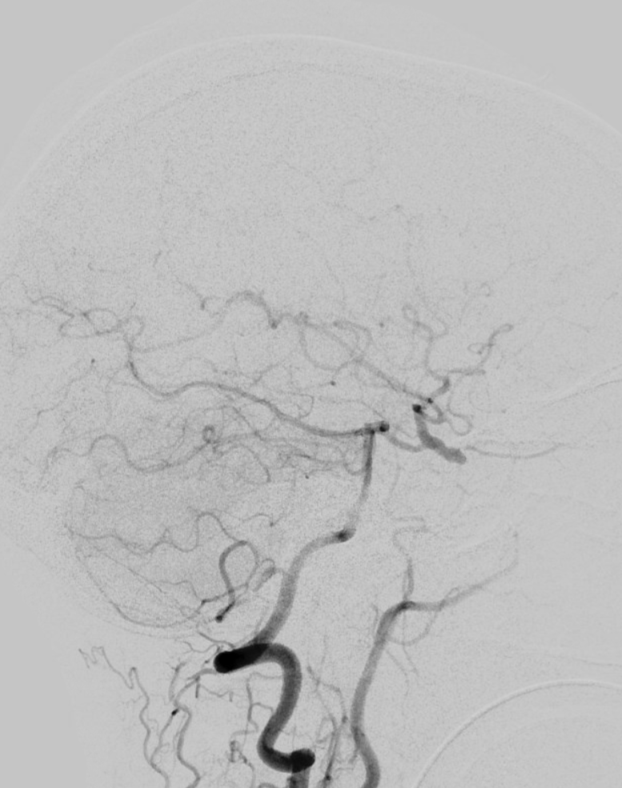

Slide 5
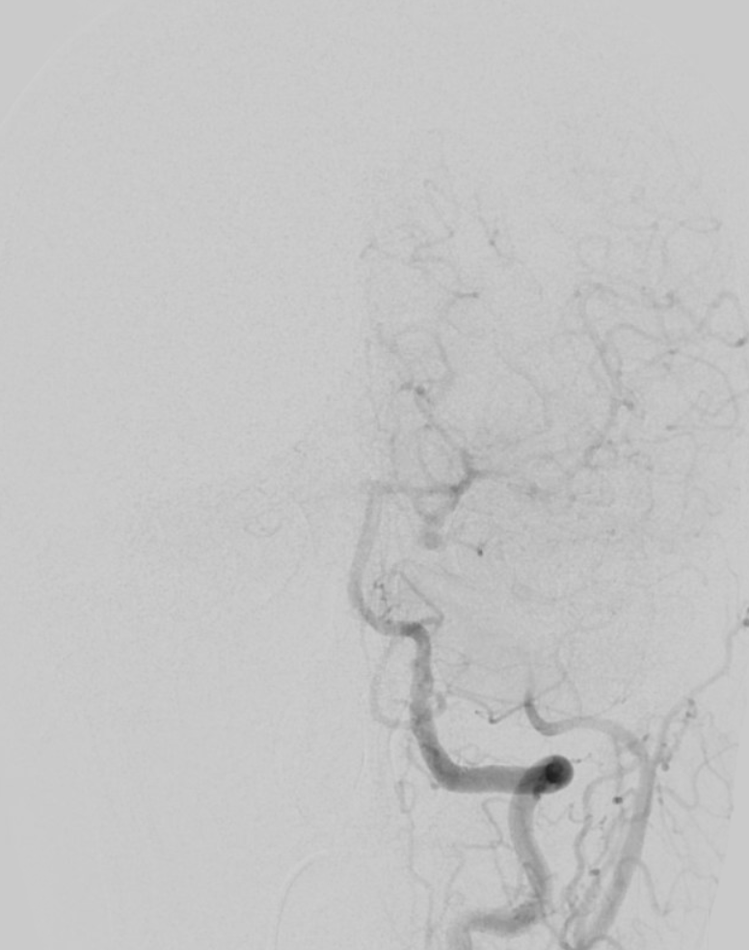

Slide 6
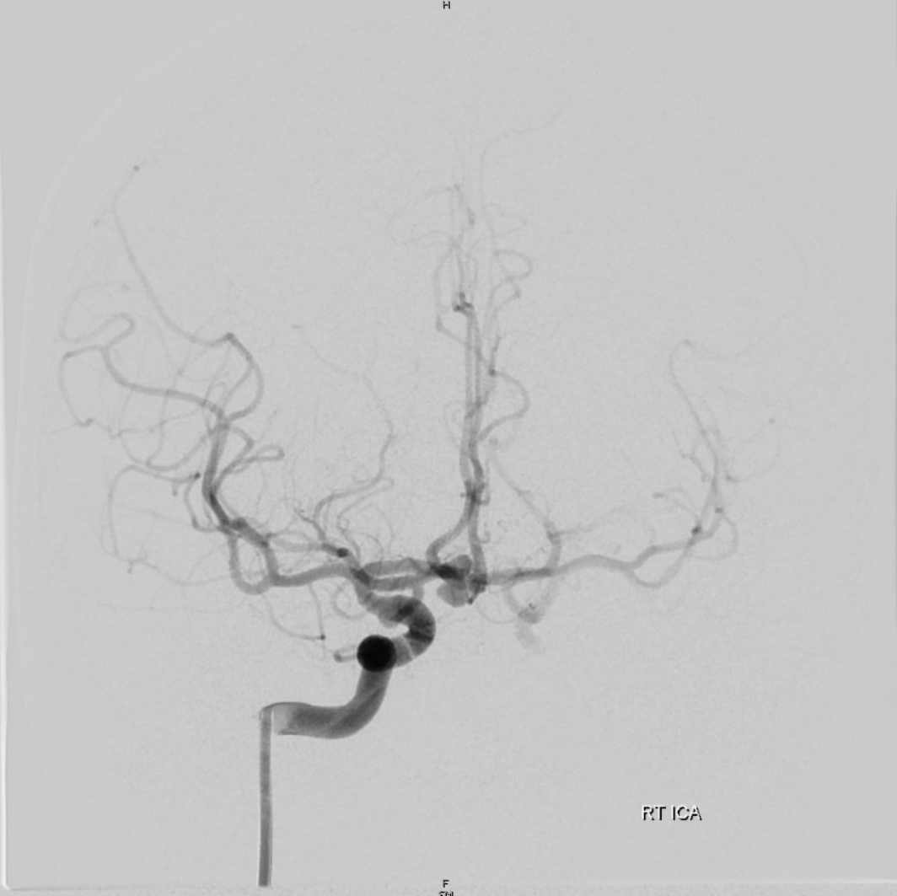
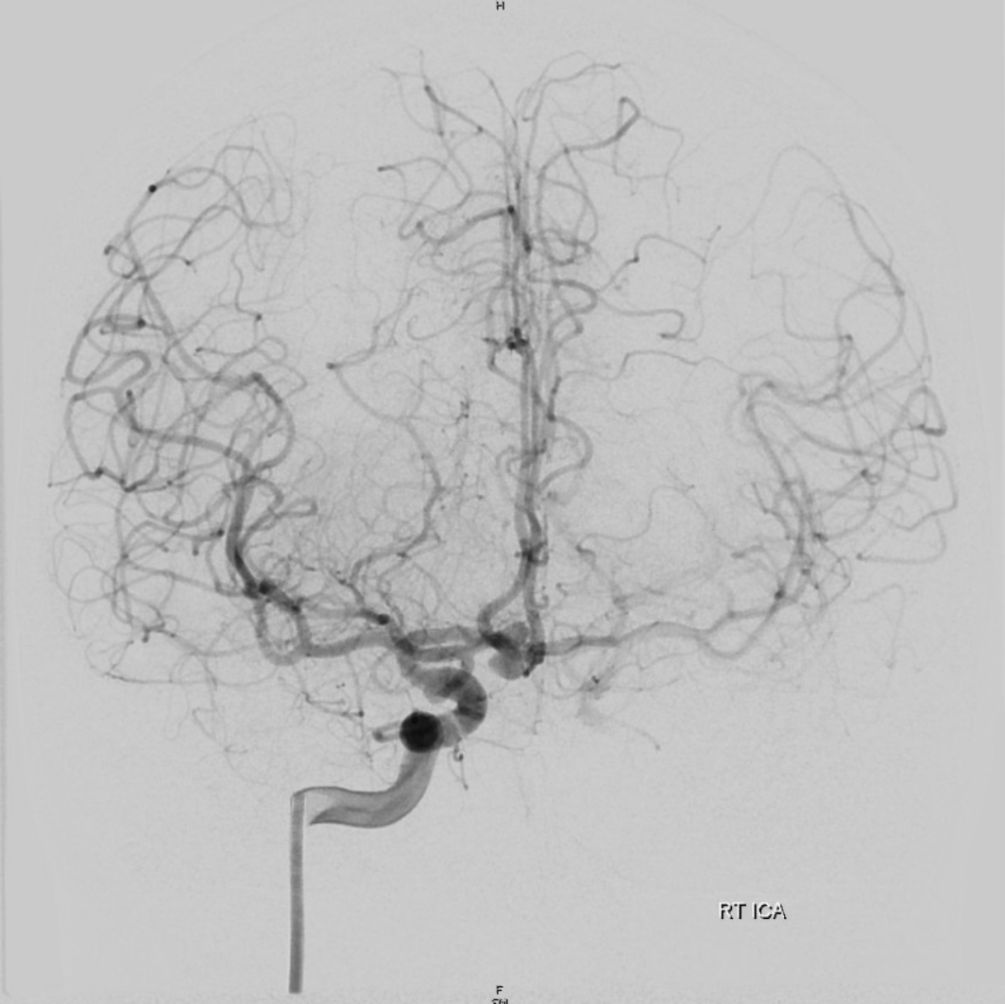
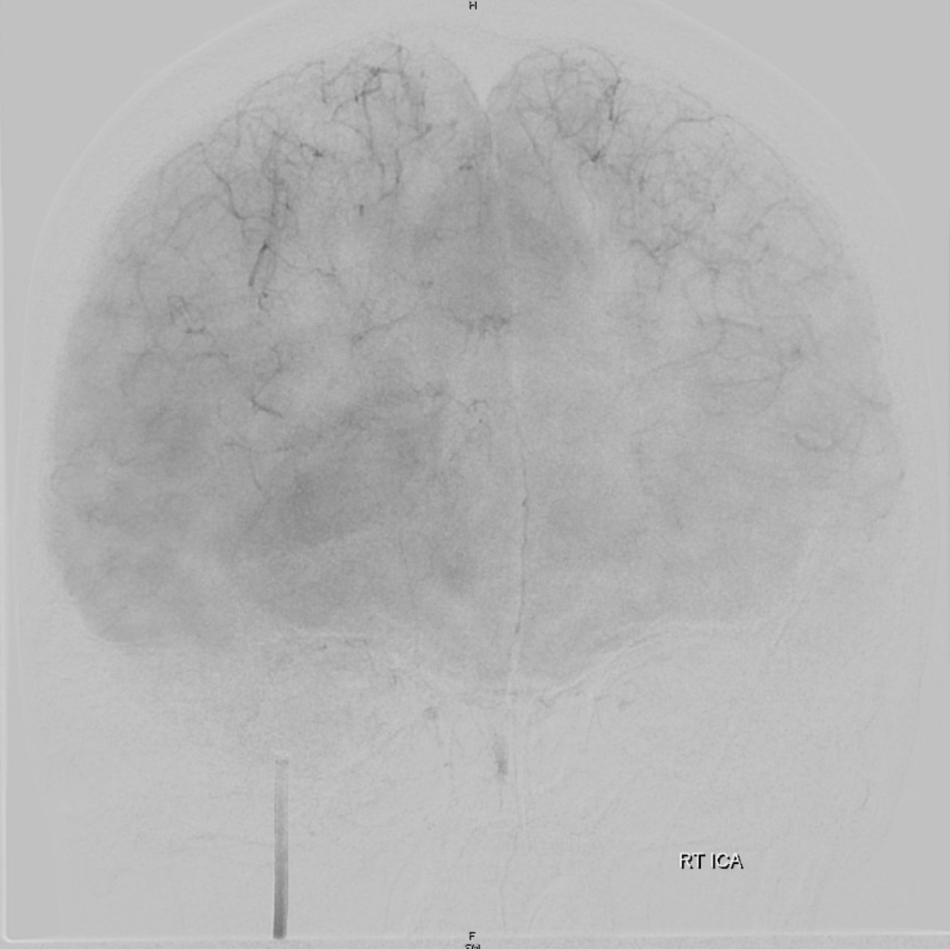
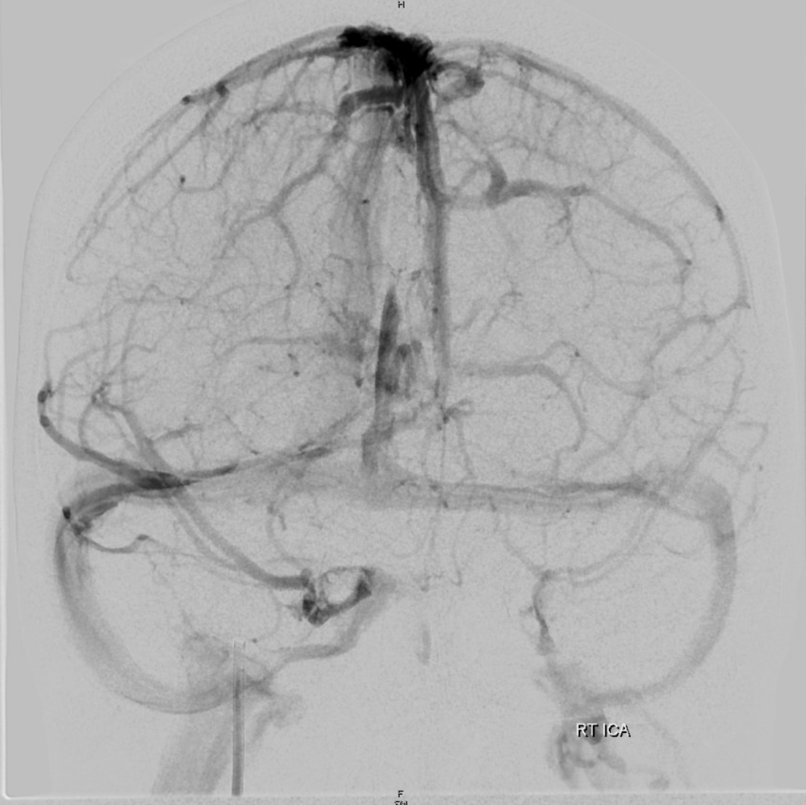

Slide 7
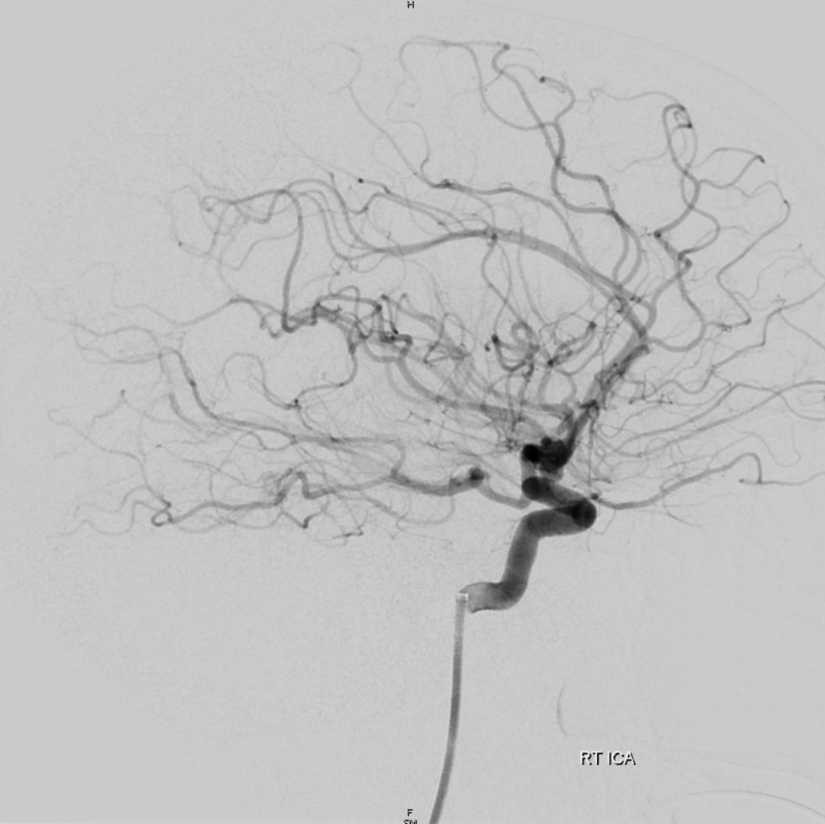

Slide 8
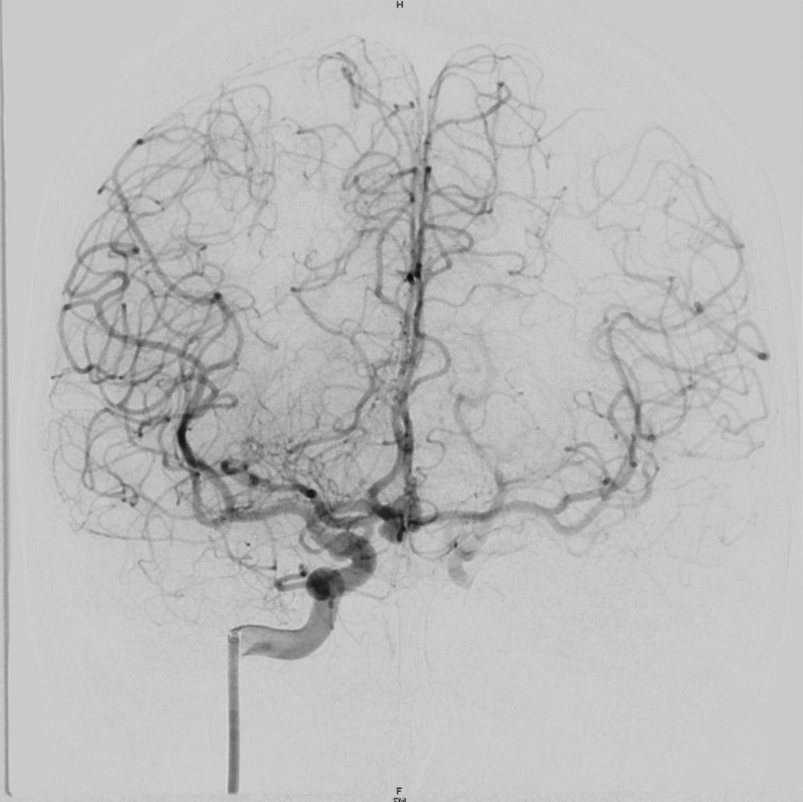

Slide 9
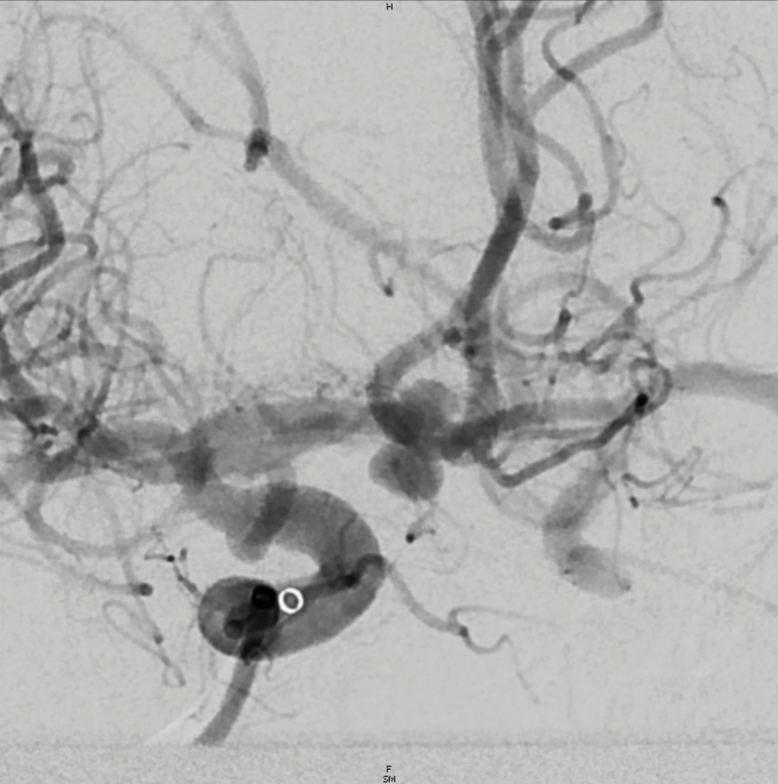
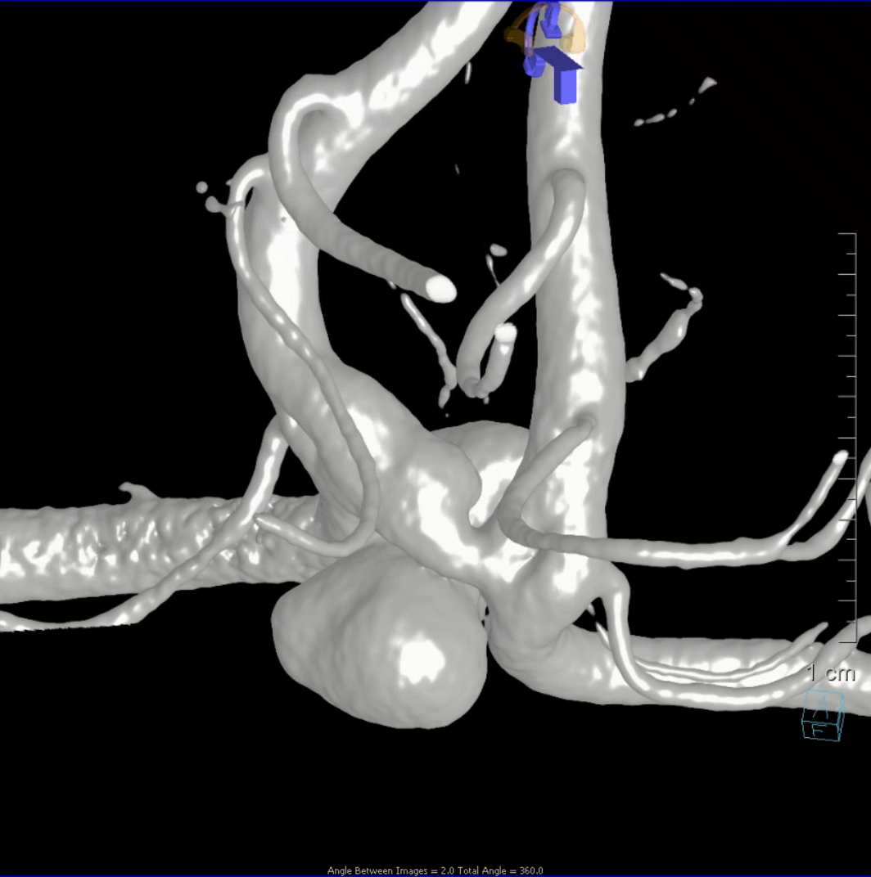
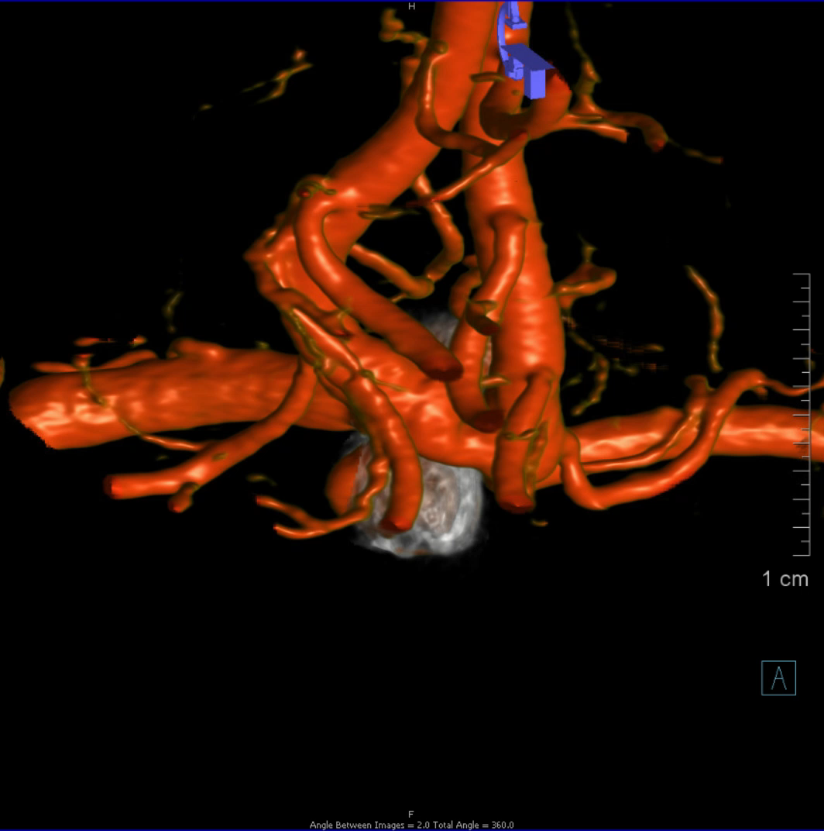
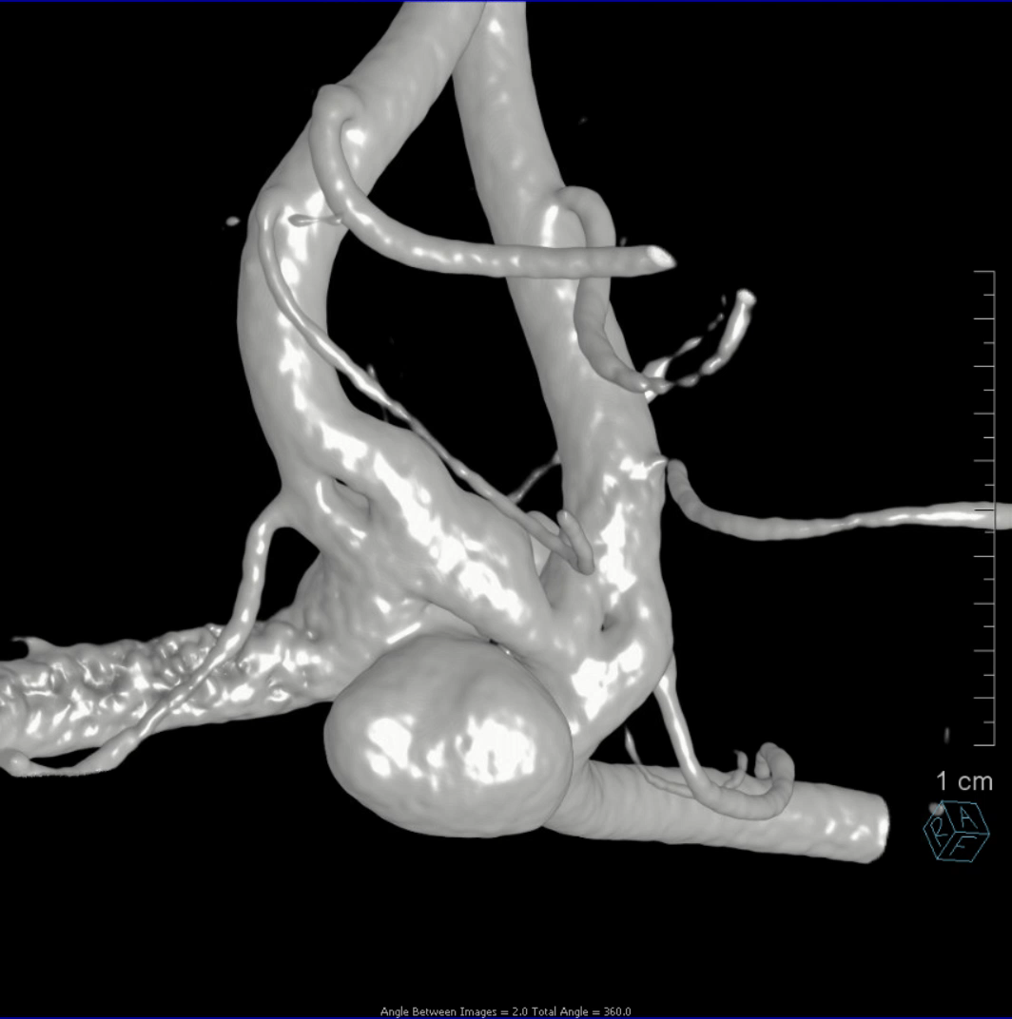
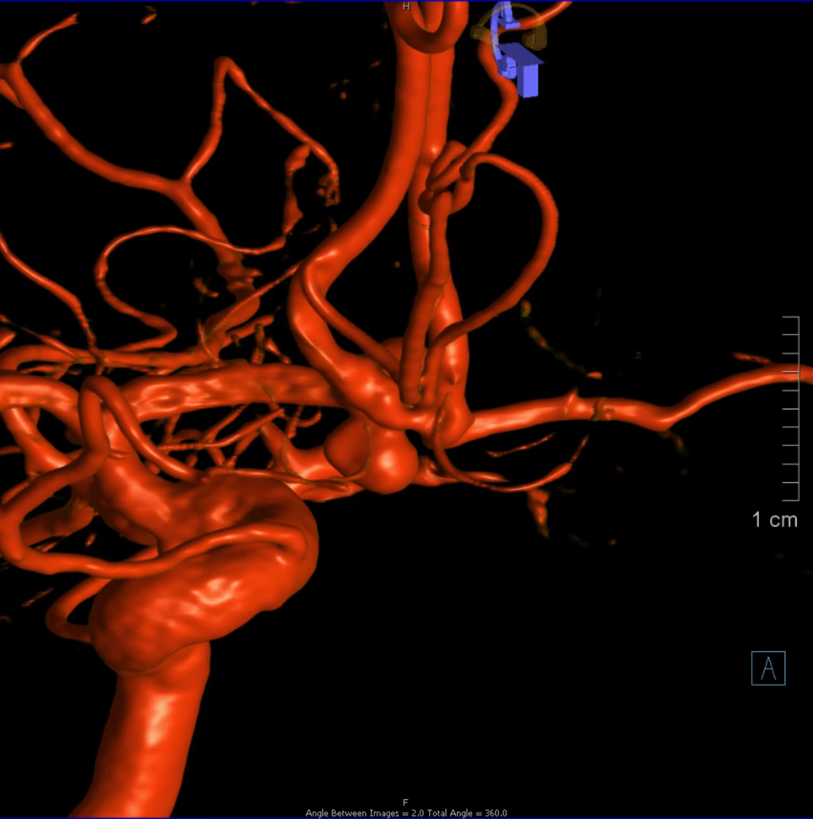

Slide 10
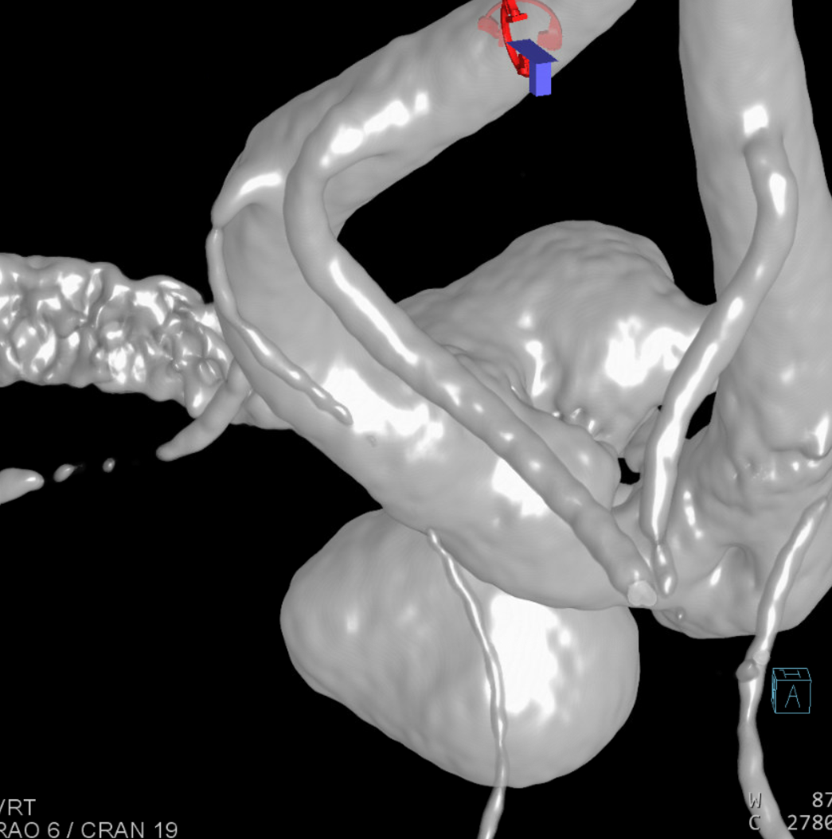
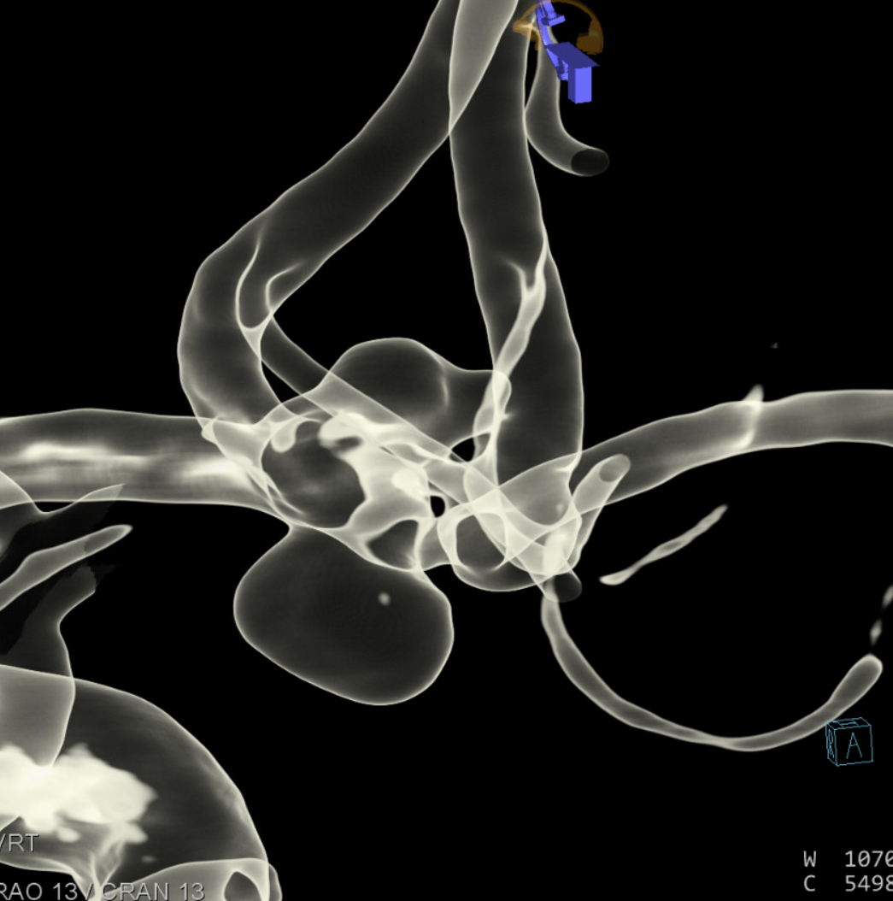
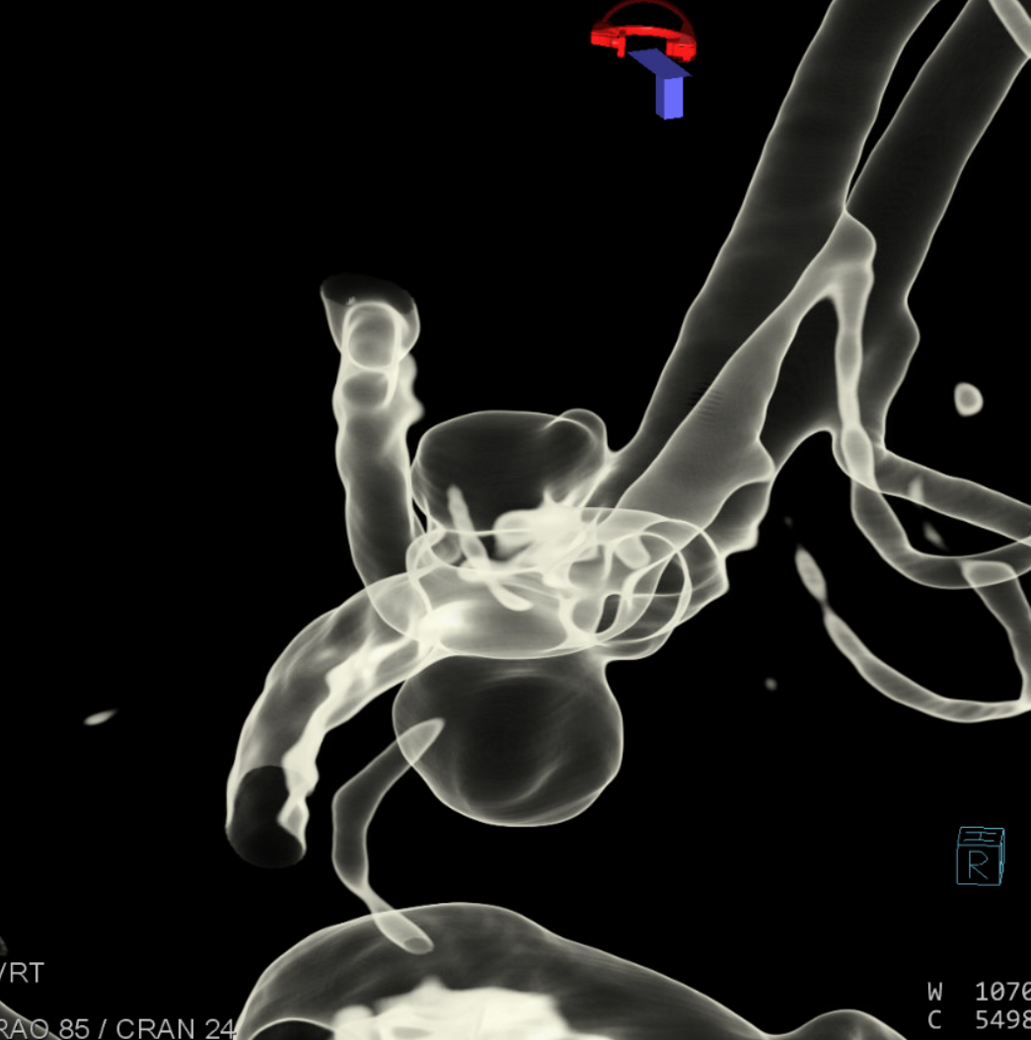
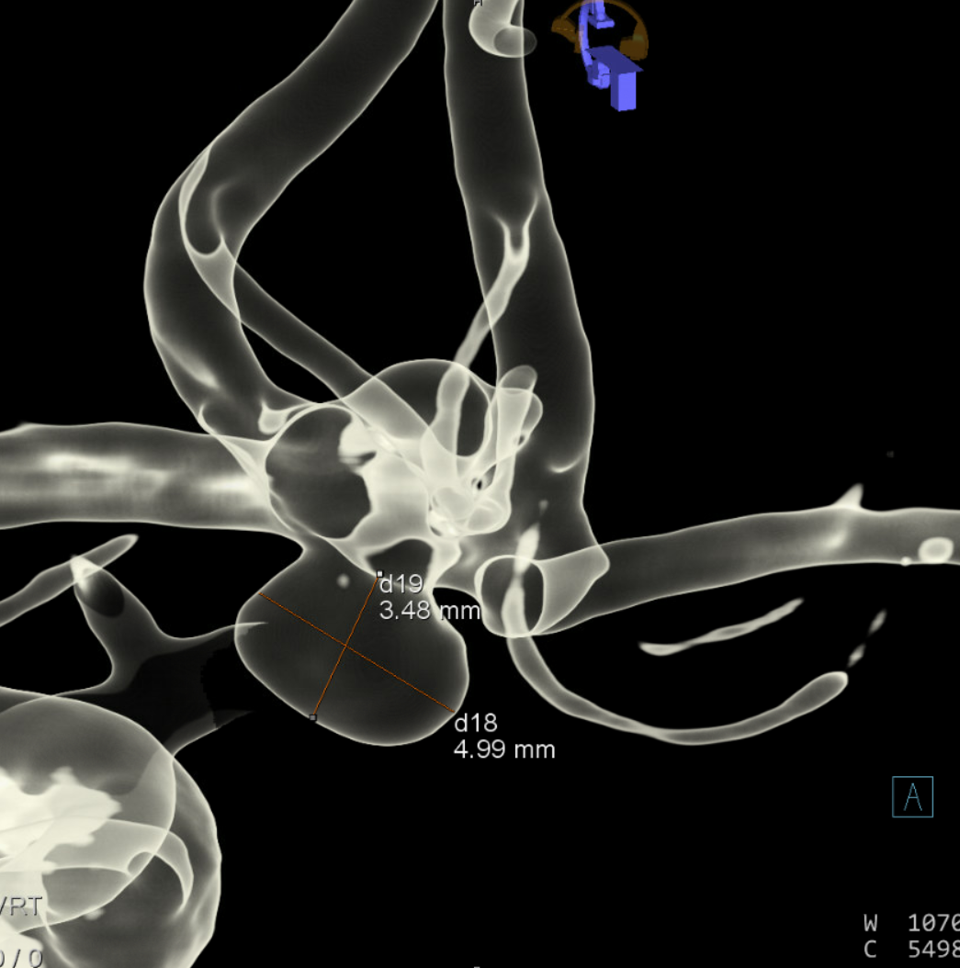

Slide 11
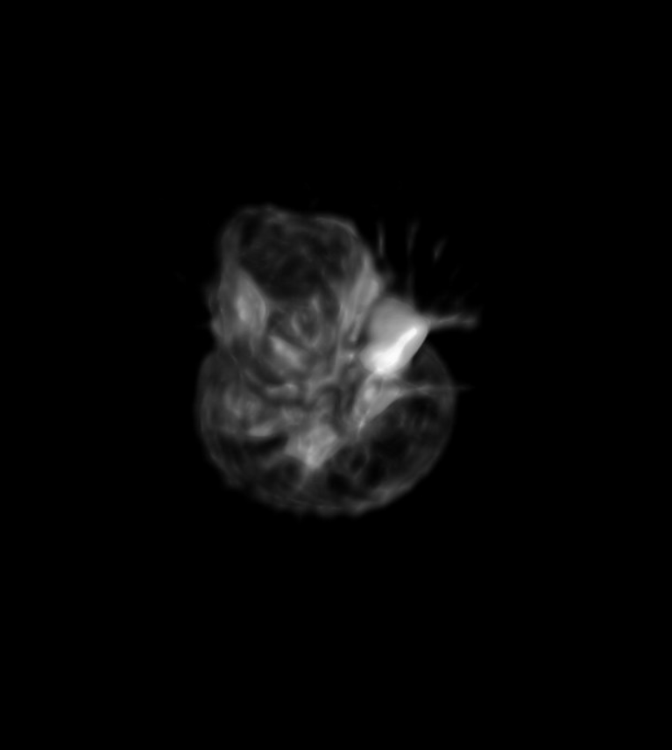
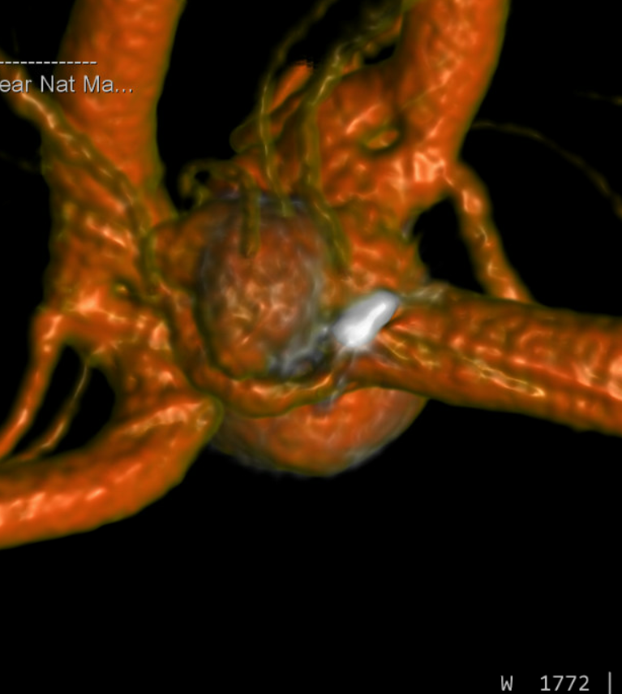
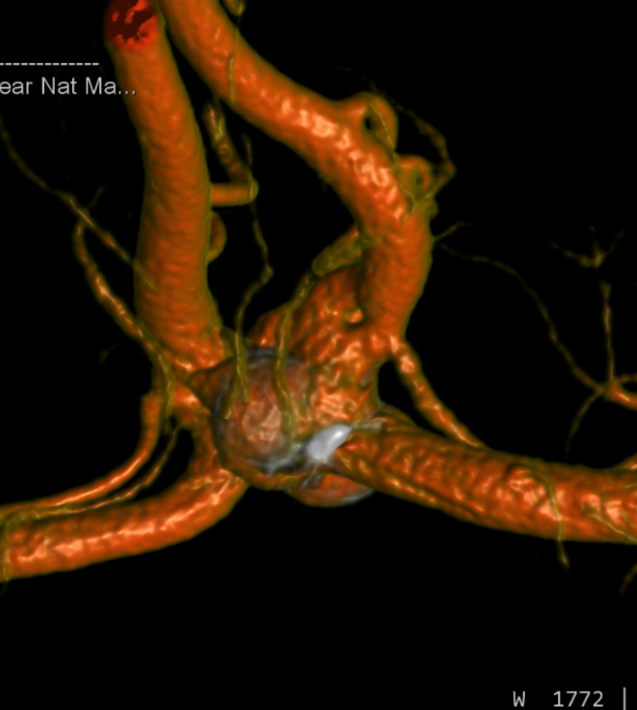
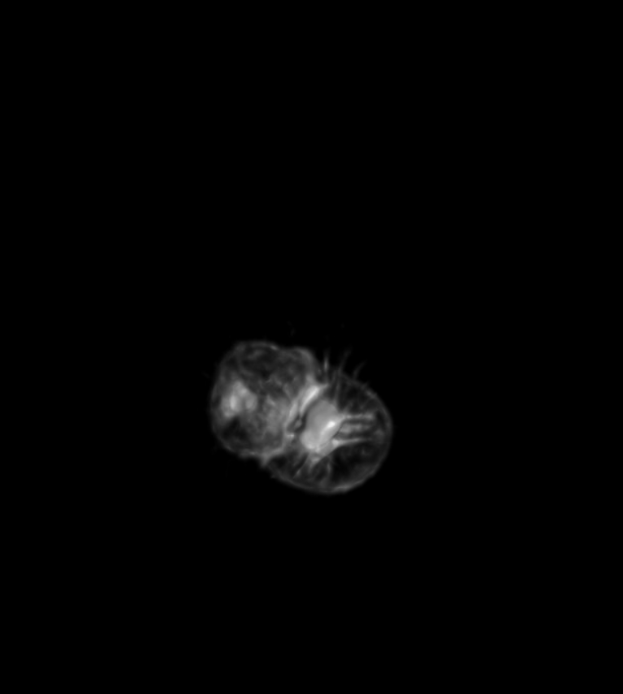

Slide 12
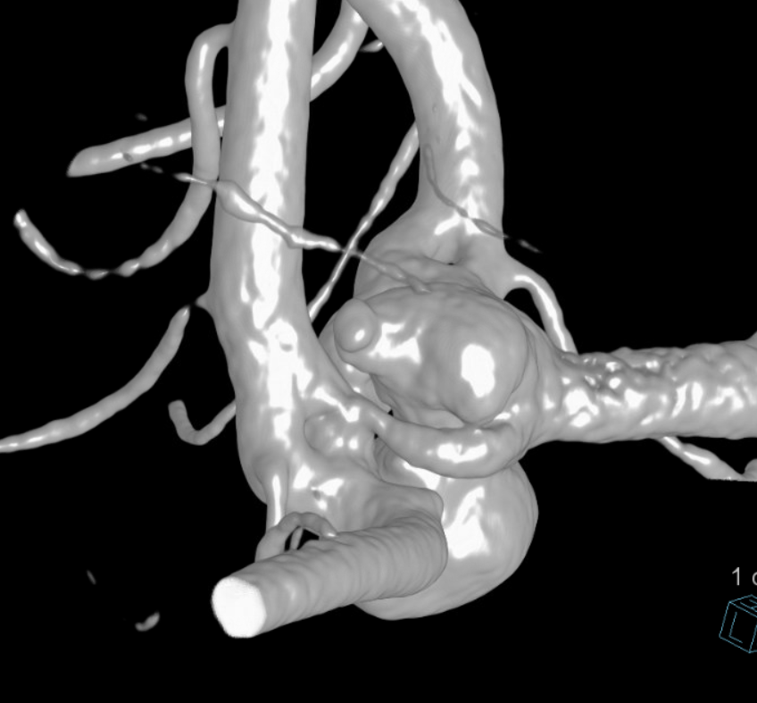
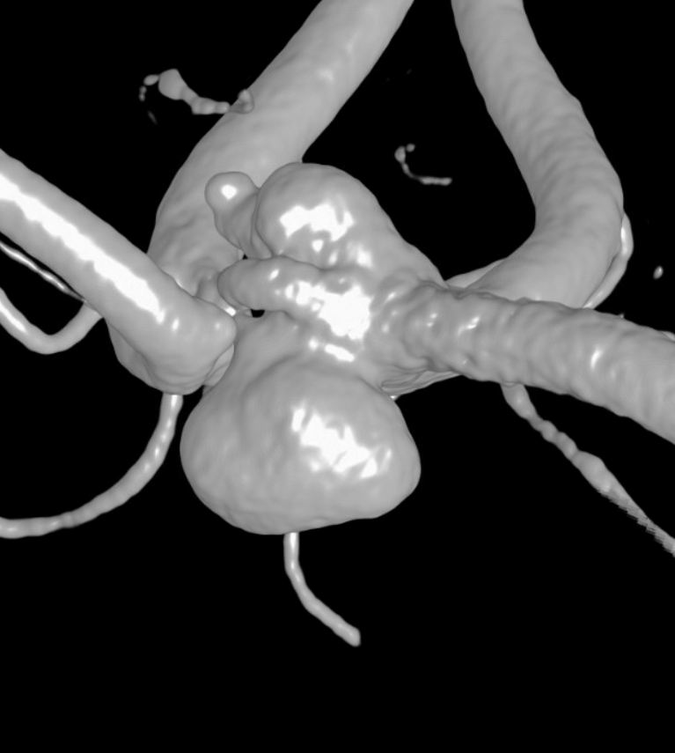
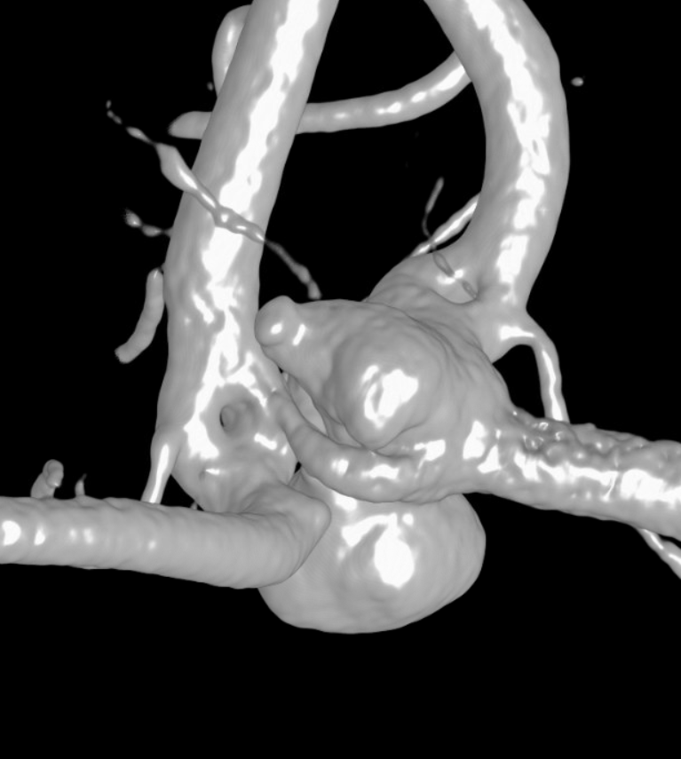
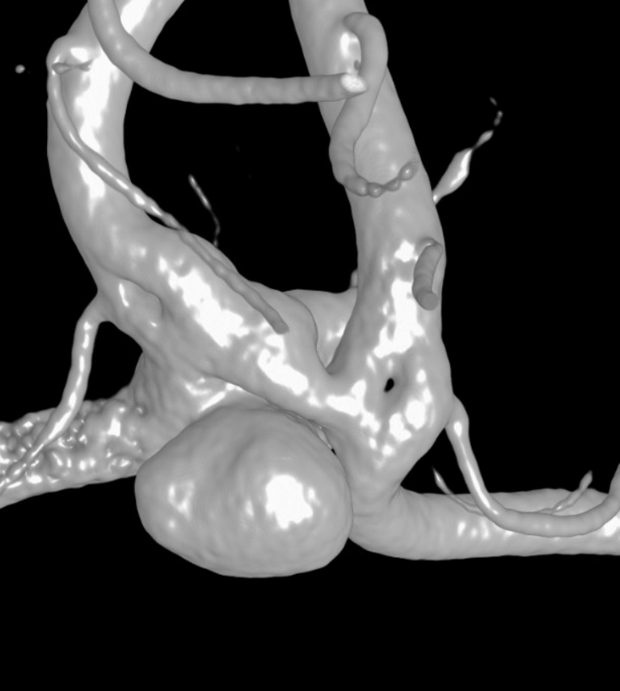
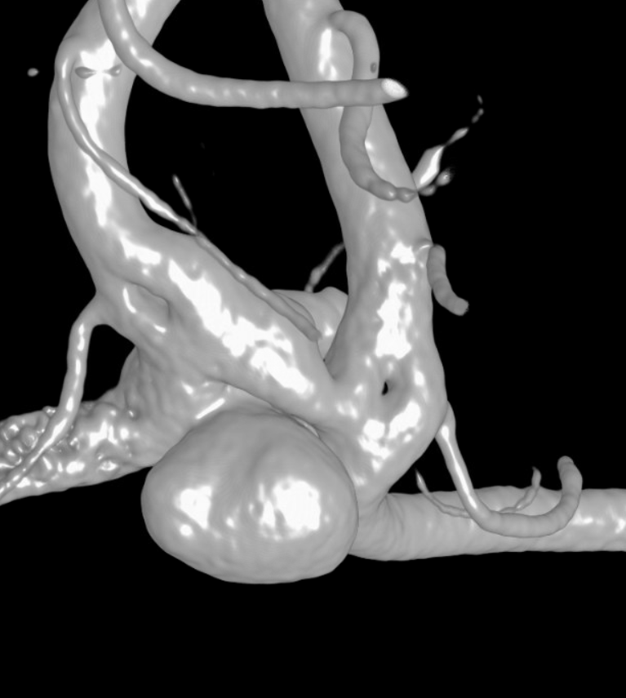
rupture point
LT A2
RT A2
LT A2
RT A2
Upper lobe
rupture point
fenestration
LT A1
LT ACOM
RT ACOM
RT A1
Upper lobe
Rt Heubner
lower
lobe
Lt Heubner
fenestration
RT A1
Lt Heubner
LT ACOM
Rt Heubner
LT A1
lower
lobe
LT A2
RT A2
LT A2
Upper lobe
RT A2
Upper lobe
fenestration
fenestration
Lt Heubner
Lt Heubner
fenestration
fenestration
RT ACOM
RT ACOM
Rt Heubner
Rt Heubner
LT A1
LT A1
lower
lobe
lower
lobe
LT A1
RT A1
RT A1

Slide 13
rupture point
LT A2
RT A2
Upper lobe
LT A1
LT ACOM
RT A1
lower
lobe
Lt Heubner
Rt Heubner
LT A2
RT A2
LT A2
Upper lobe
RT A2
Upper lobe
fenestration
fenestration
Lt Heubner
Lt Heubner
fenestration
fenestration
RT ACOM
RT ACOM
Rt Heubner
Rt Heubner
LT A1
LT A1
lower
lobe
lower
lobe
LT A1
RT A1
RT A1

Slide 14
RT A2
fenestration
LT A2
Rt Heubner
rupture point
Upper lobe
fenestration
RT A1
LT ACOM
lower
lobe
Lt Heubner
LT A1
LT A1

Slide 15
LT A2
RT A2
rupture point
Upper lobe
RT ACOM
LT A1
LT ACOM
RT A1
lower
lobe
LT A1

Slide 16
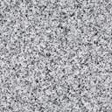
LT A2
RT A2
rupture point
Upper lobe
RT ACOM
LT A1
LT ACOM
RT A1
lower
lobe
LT A1

Slide 17
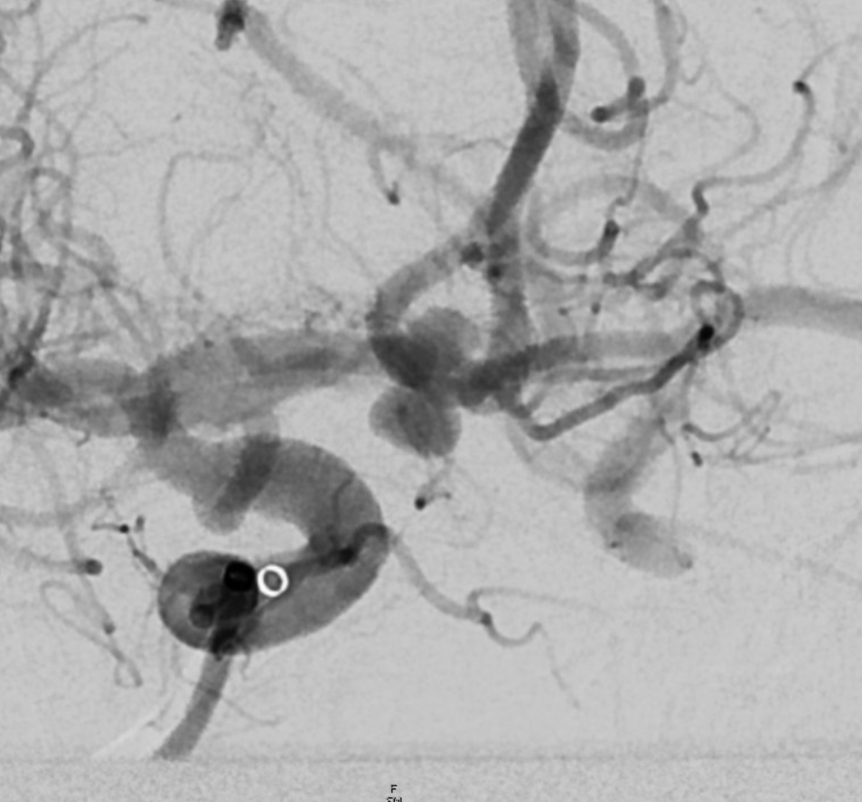
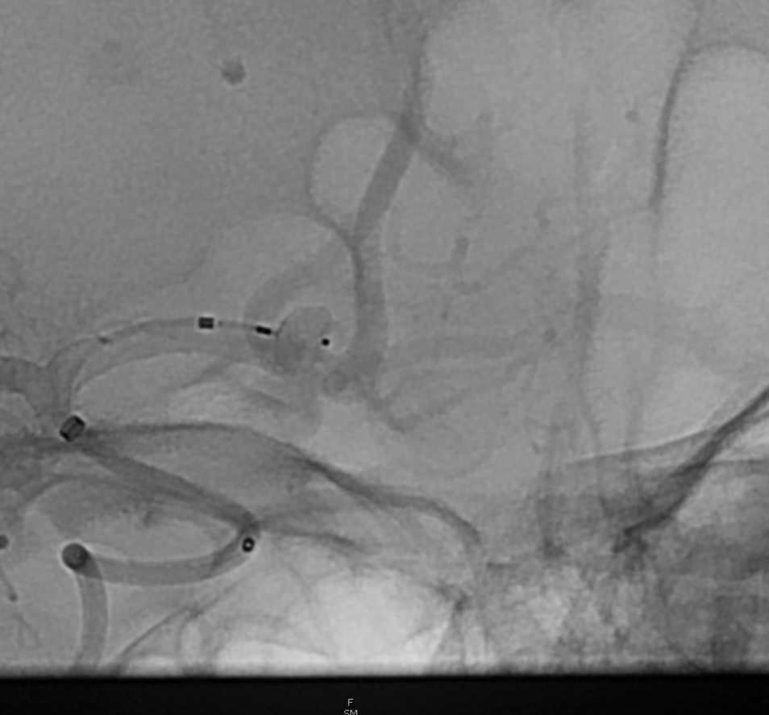
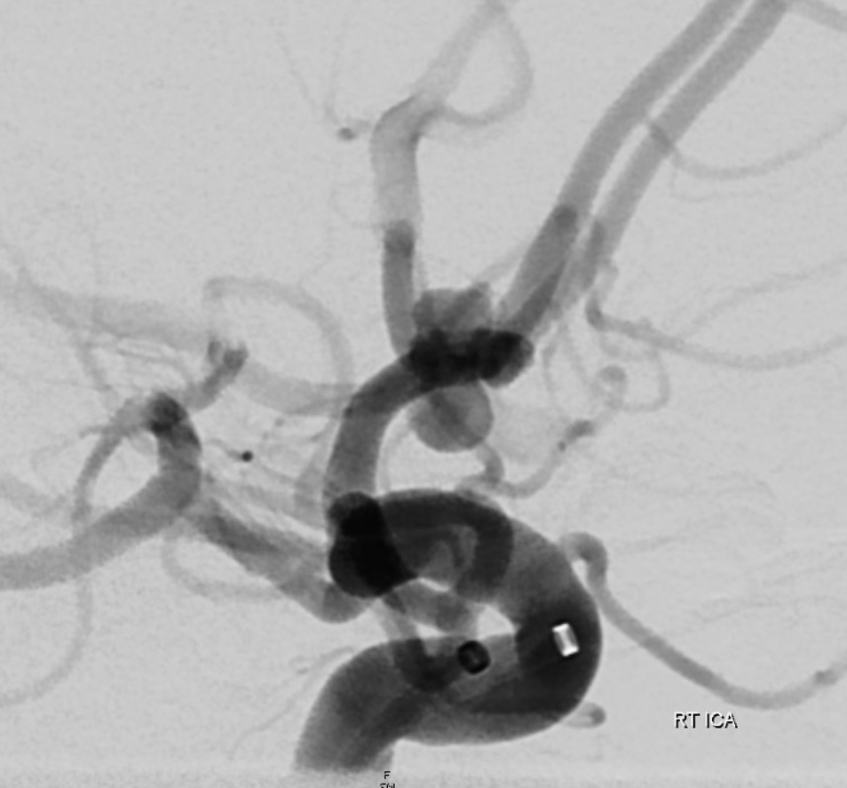
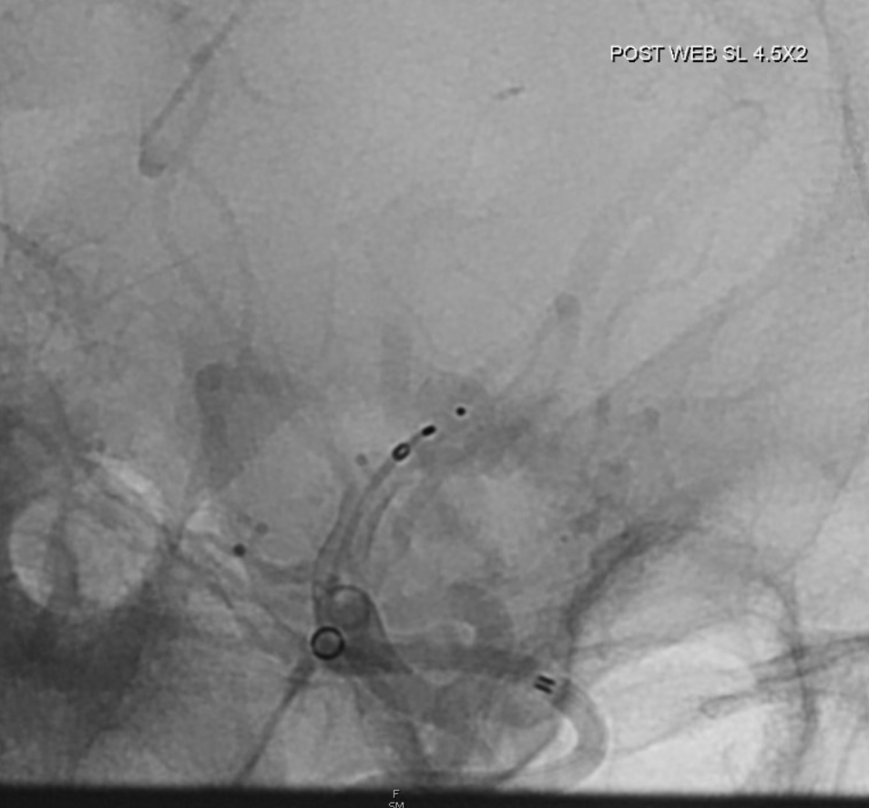

Slide 18
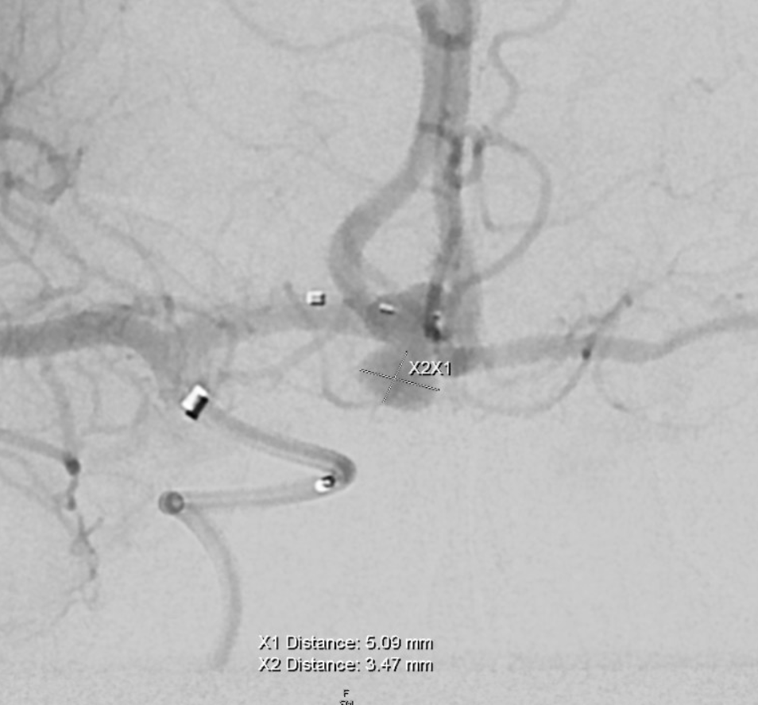
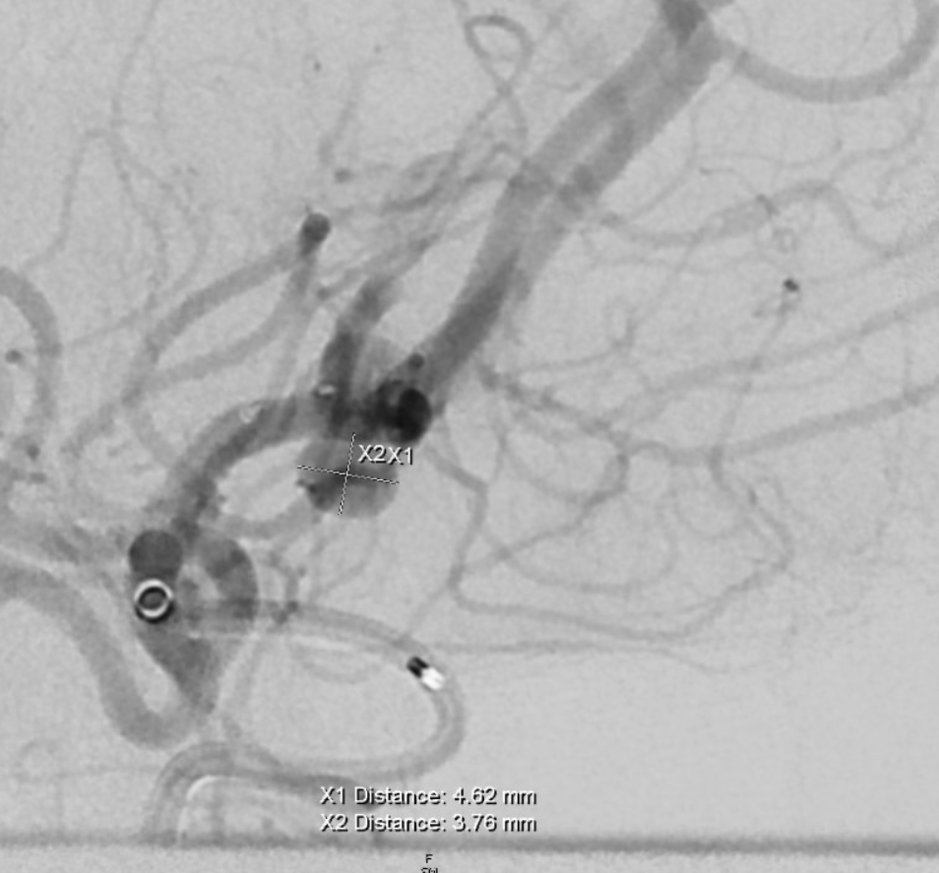
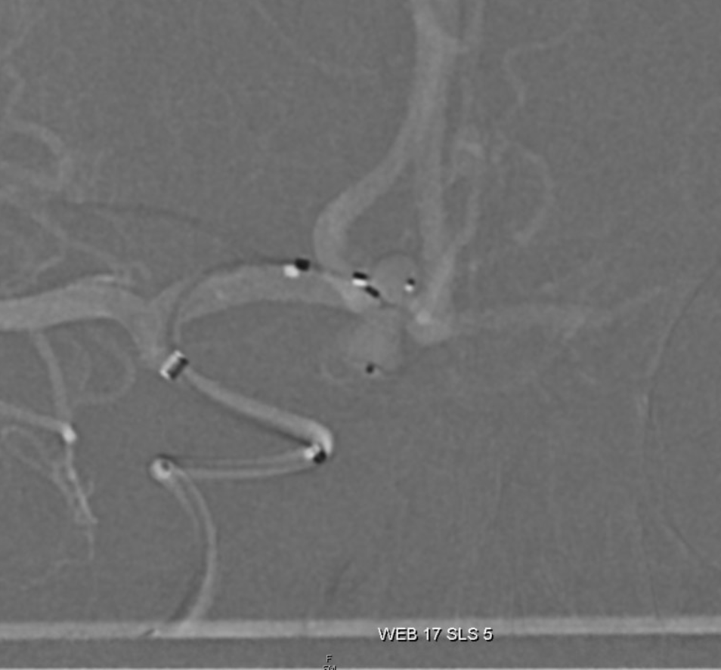
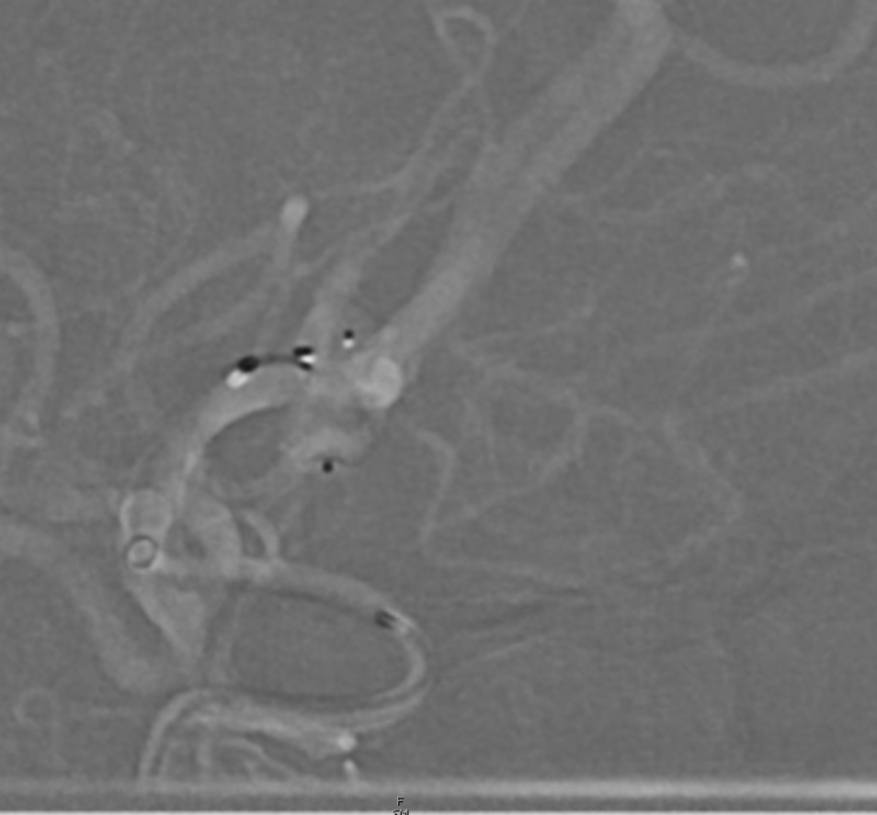

Slide 19
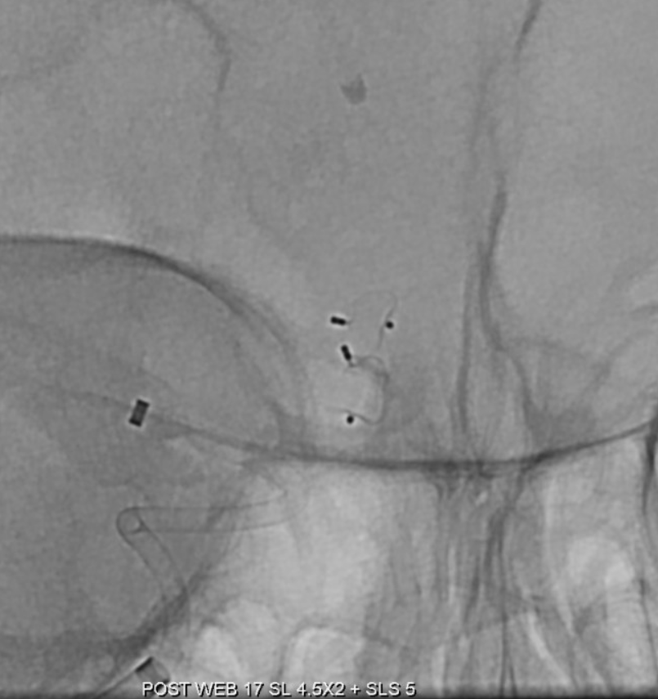
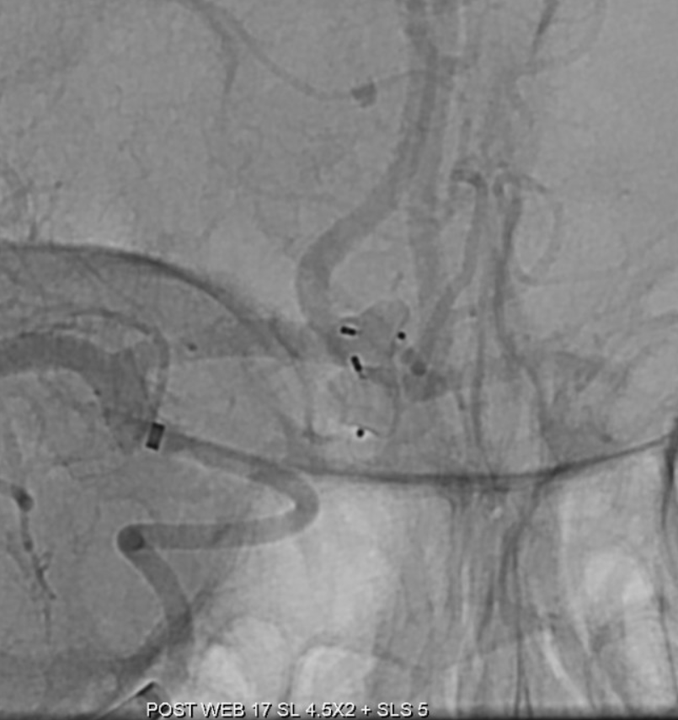
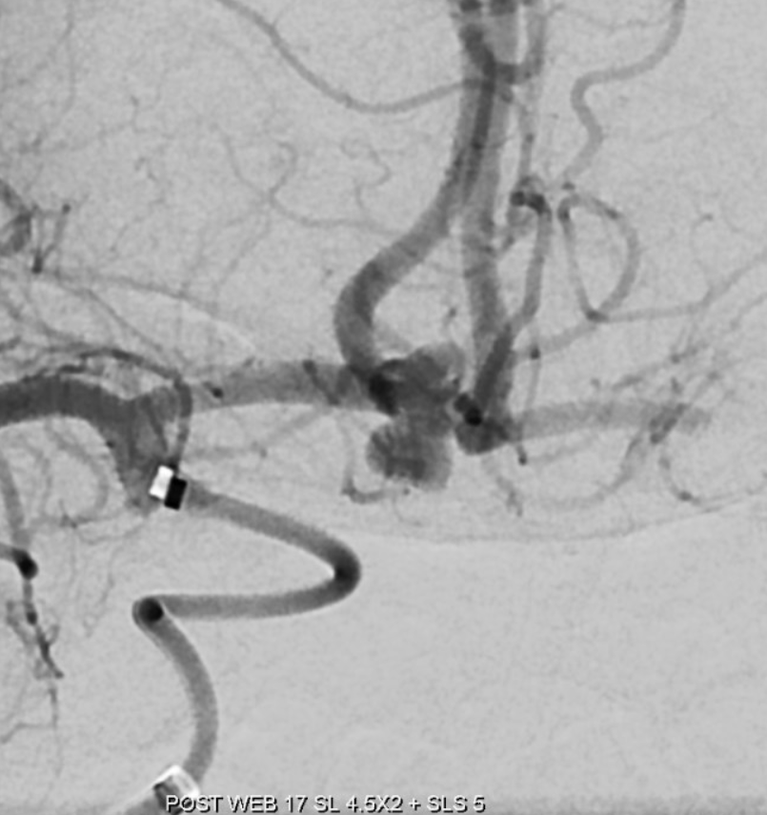
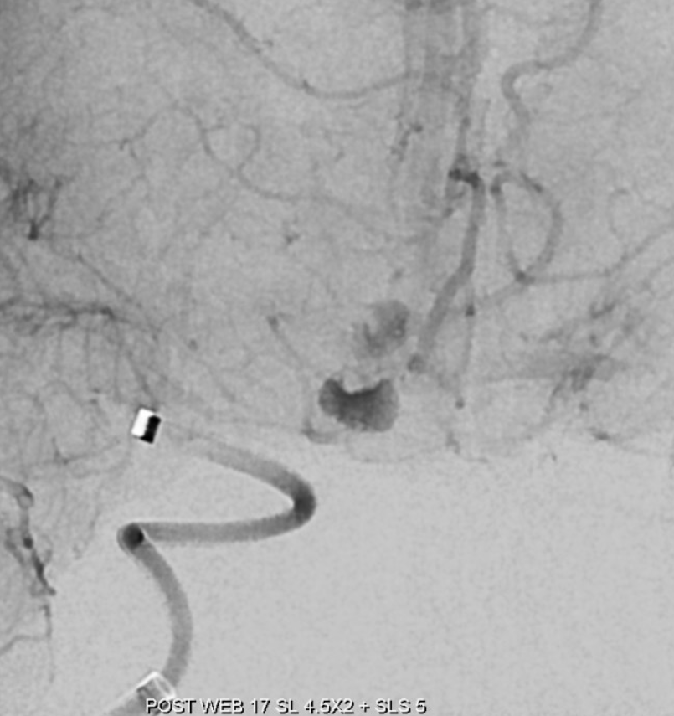

Slide 20





Slide 21





Slide 22





